Slide 1
Monitoring: 2010 Edition
James Jarvis
APRS World, LLC
www.aprsworld.com
Outline for presentation:
Site Assessment
Turbine Testing
Deployment
Incentives

Slide 2
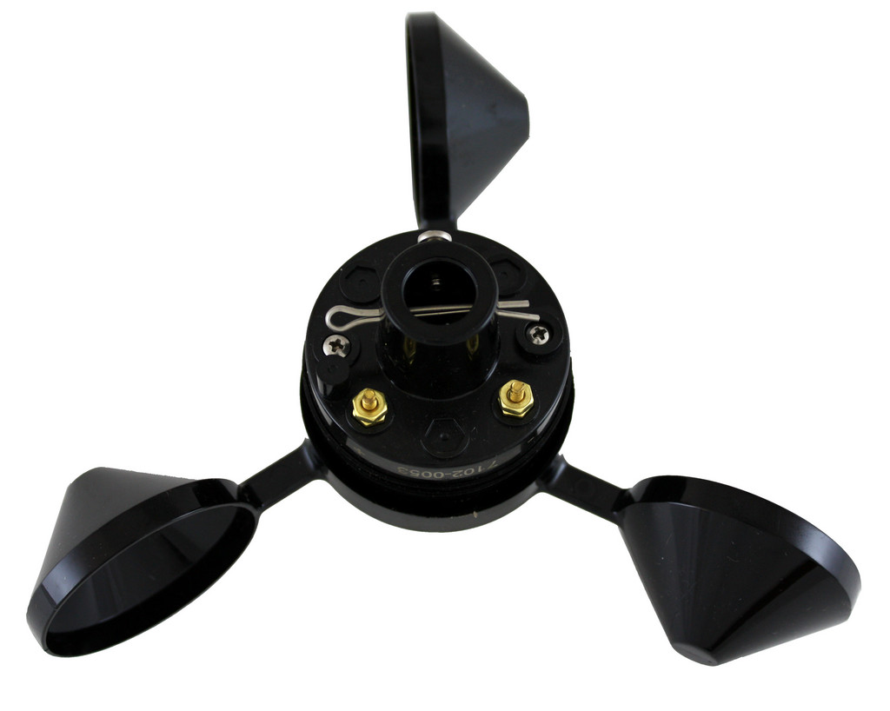
Site Assessment

Slide 3
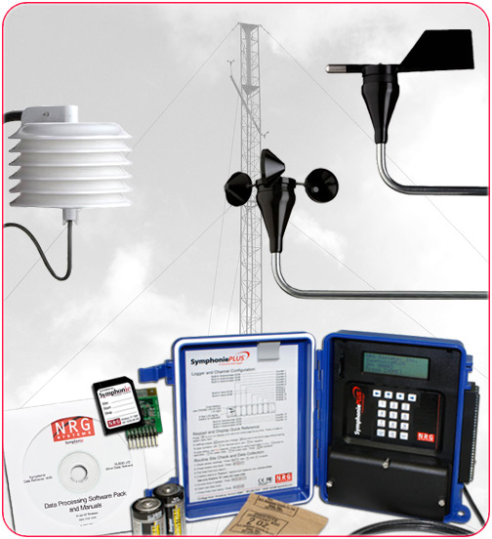
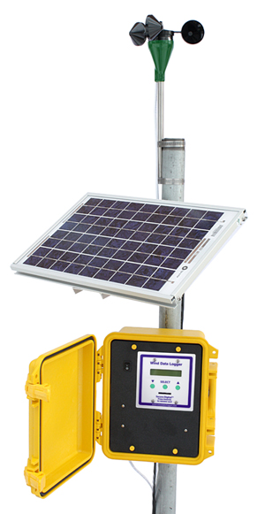
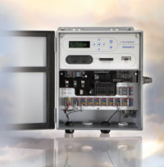
Site Assessment (is not happening)
Hardware available and more cost effective than ever
Why not?
Still expensive
Delays sales process
Not required for incentives

Slide 4
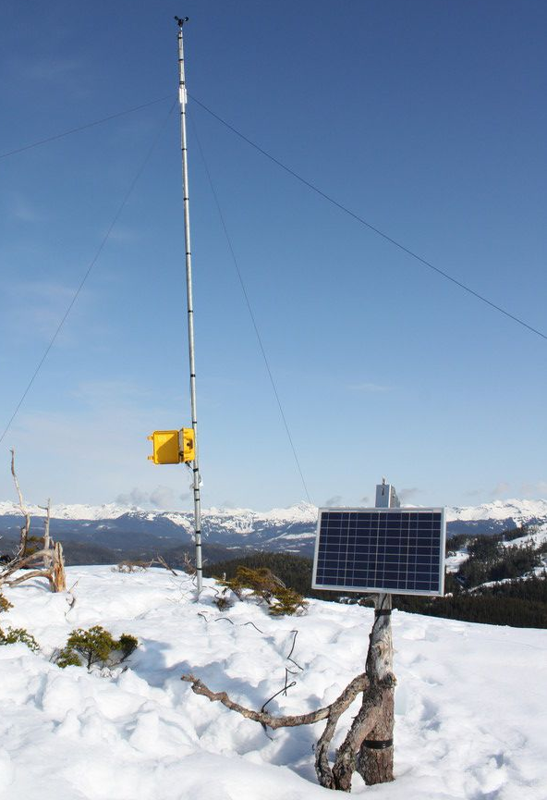
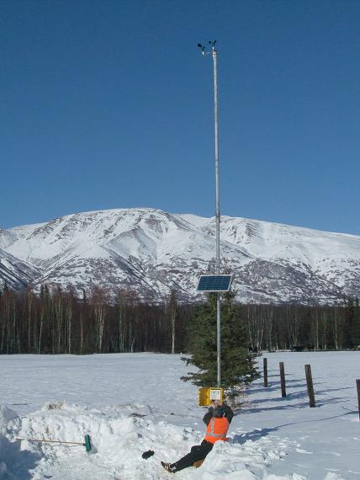
Site Assessment (is happening)
Large wind
Still seeing MET towers at wind farms under construction
Educational
New installers & new geography

Slide 5
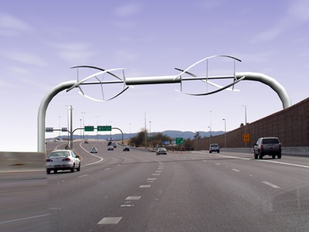
Turbine Testing
(It is HORIZONTAL AXIS!)

Slide 6
Sales (are happening)
(responsible) industry is pushing towards verified and performing turbines
Small Wind Certification Council (SWCC) requiring testing to AWEA standards

Slide 7
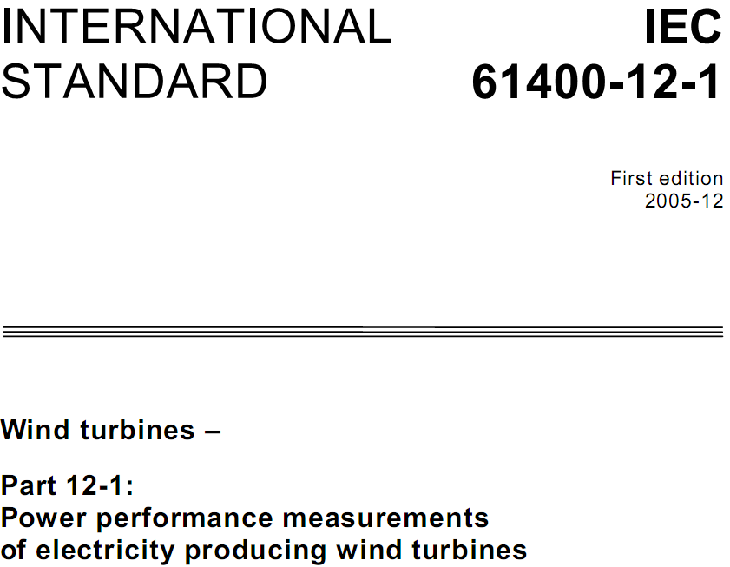
Manufacturer Testing (pre SWCC)
Excellent
Test with lab to IEC 61400-12 standards
Very expensive for small wind
Many $$$ of labor and equipment
Accredited laboratory required
Hundreds of pages and thousands of dollars for the standards

Slide 8
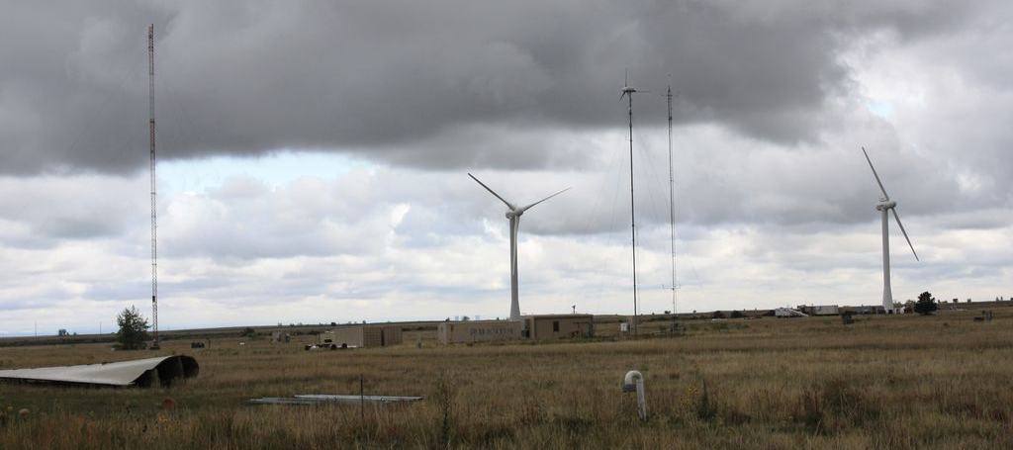
National Renewable Energy Lab
Has developed techniques for IEC testing, but does not want to provide it as a commercial service

Slide 9
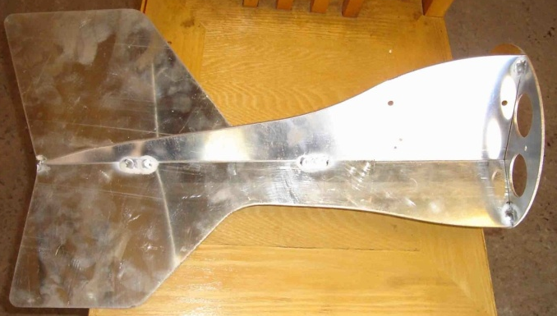
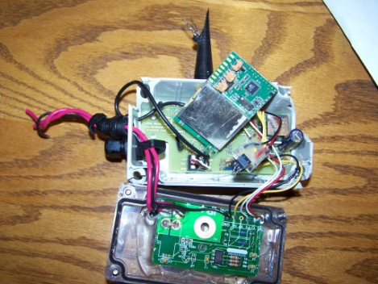
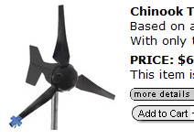
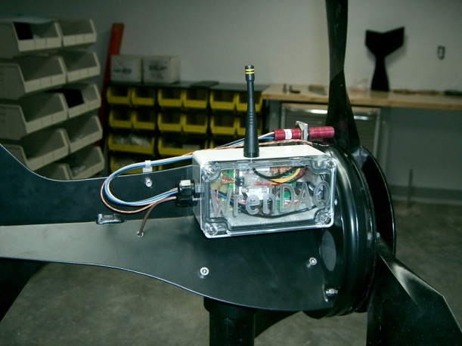
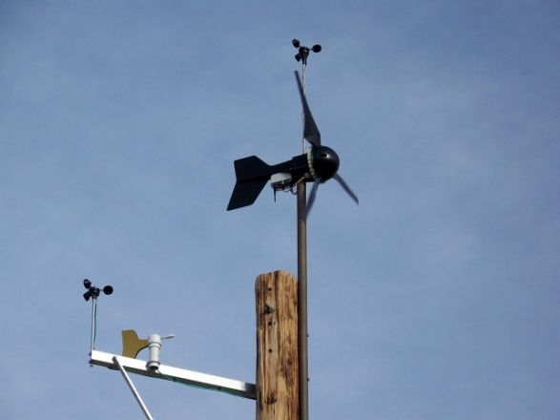
Manufacturer Testing (pre SWCC)
Good
Data and test driven design
Extensive field testing with manufacturer or customer supplied monitoring

Slide 10
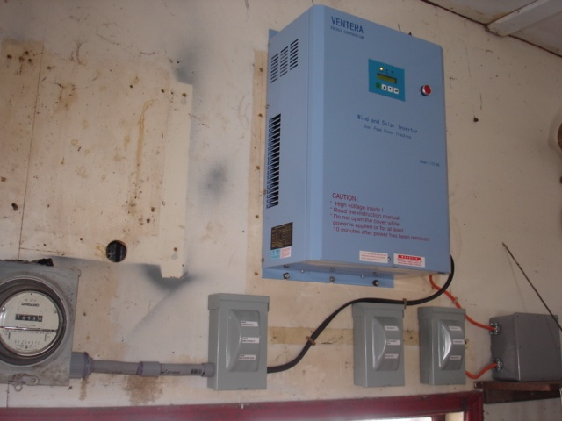
Manufacturer Testing (pre SWCC)
Bad, but better than nothing
KWH meters on turbine output
No wind data

Slide 11
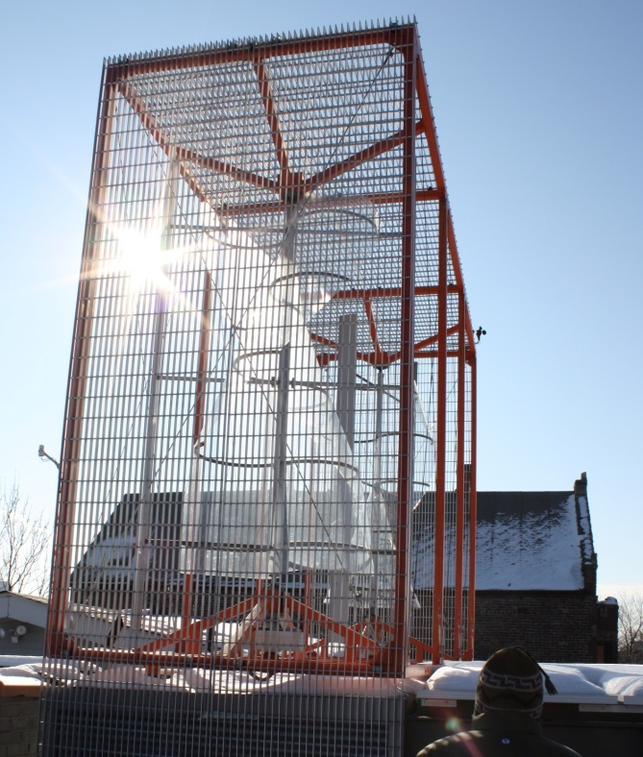
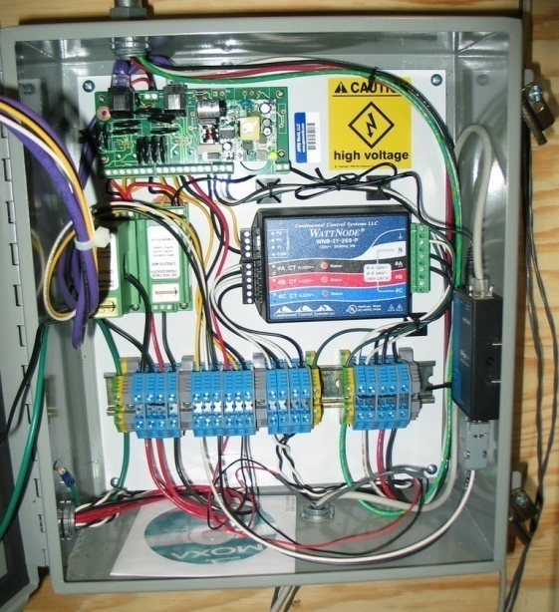
Manufacturer Testing (pre SWCC)
UGLY
Ship it and let the customer see if it works
(end user spent thousands to monitor their turbines that have produced $0)

Slide 12
Small Wind Certification Council
Data driven testing process
Designed and relatively affordable for small wind
Testing of:
Power Performance
Acoustic
Duration
Design Verification of:
Safety and function
Structure

Slide 13
AWEA / SWCC Testing (continued)
Power performance
Power, voltage, current versus standardized wind conditions
Acoustic
Rated sound level, changes in sound
Duration
Vibration, hours of operation, hours of power production, turbulence, power degradation

Slide 14
Manufacturer Testing Requirements (for SWCC / AWEA)
Characterized test site with full range of wind conditions
Calibrated equipment
Documented processes
Accredited laboratory and/or review by SWCC for proper operation and correct data

Slide 15
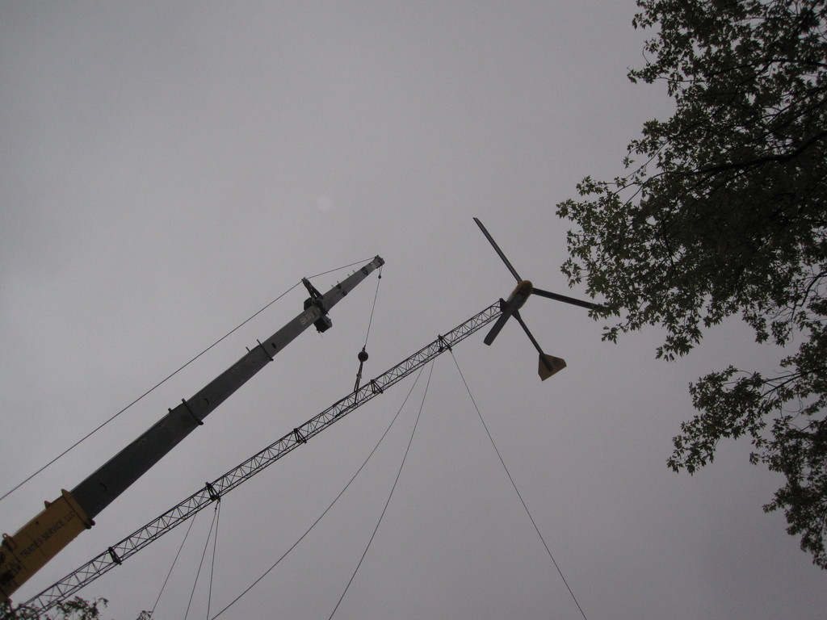
Deployment

Slide 16
Remote Monitoring from the turbine manufacturers
Picking on our conference sponsors:
Everyone else: ???
 | Bergey | Xzeres | SWWP | Endurance | WTI | Fortis
Mentioned On MFG web: | No | No | Barely | Yes! | No (just announced) | Barely
Availability: | Partner | Inverter Supplier | No | Direct | Direct | Inverter Supplier
Price (MSRP): | $650 | $600 |  | $0 | ? | $600
Anemometer: | + $$$ | + $$$ | No | $0 | ? | + $$$
Web Monitoring: | Yes Automatic | $$$ + hardware + configuration | No | Yes | Yes Automatic | $$$ + hardware + configuration

Slide 17
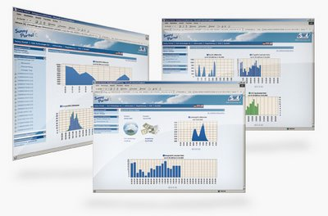
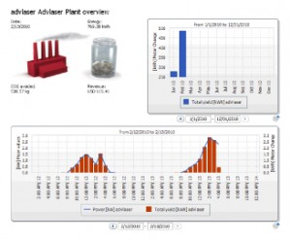
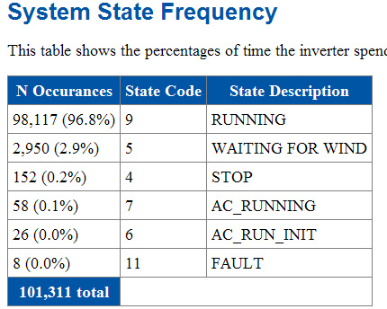
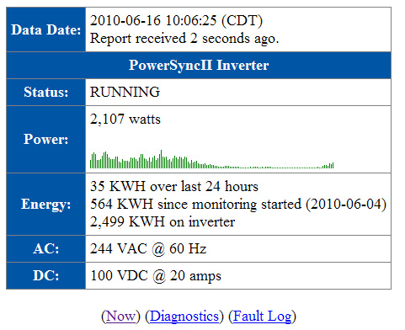
Manufacturer Examples
Xzeres and Fortis using
SMA inverters using SUNNY WEBBOX:
Bergey:
WTI and Endurance:
???

Slide 18
Remote Monitoring from third parties
Pros
Cons
Available for anything
Accurate (for $$$)
Flexible
May be customizable
Expensive
Time consuming to install
Complex
May not be reliable
Often custom
Lead time

Slide 19
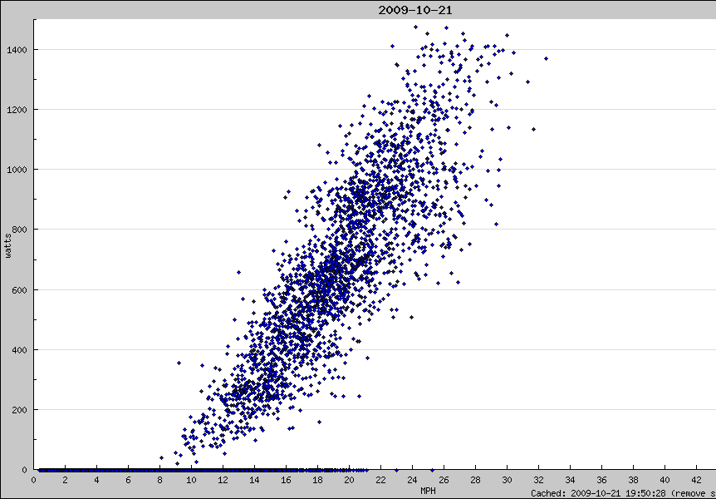
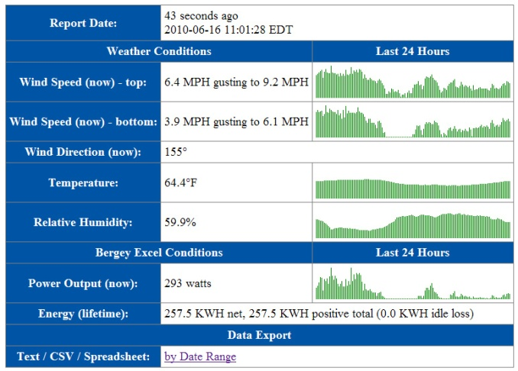
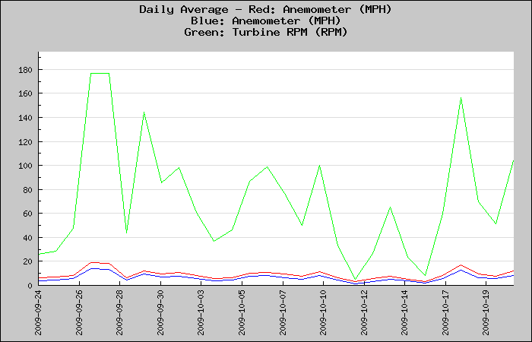
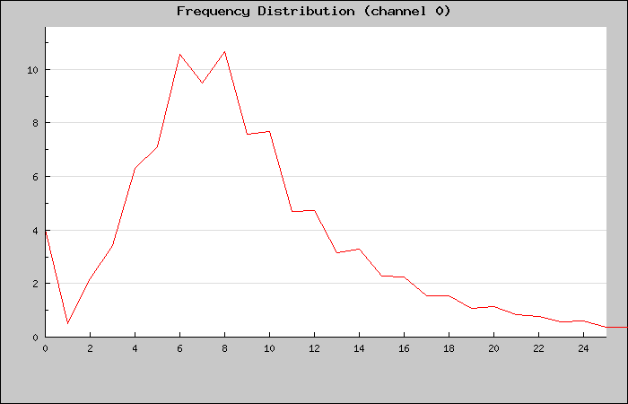
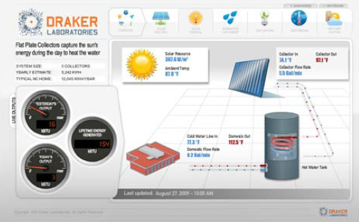
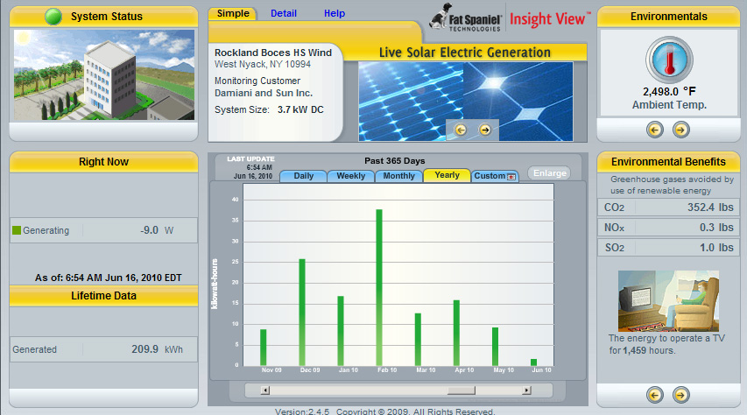
Third Party Examples

Slide 20
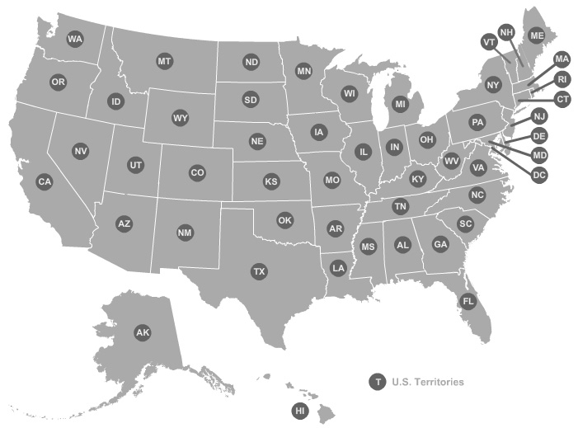
Incentives
Map from DSIREusa.org

Slide 21
State Incentives
From DSIRE (June 2010):
Site assessment monitoring typically not required
Some incentives require performance monitoring
Little or no production incentives

Slide 22
Incentive Performance Monitoring
Many states with small wind incentives require wind speed and production data hardware to be installed
Collection of data is often sporadic and not well defined
Massachusetts Clean Energy Center incentives require:
Two anemometers and a wind vane
Temperature
Power measurement
And prefer automatic reporting of 1 minute or faster data

Slide 23
Production Incentives
Question: Why no production incentives?

Slide 24
My Thoughts
Industry is maturing and is certifying turbines
Let’s make sure they stay working in the field
Let’s incentivize those that do work

