Slide 1
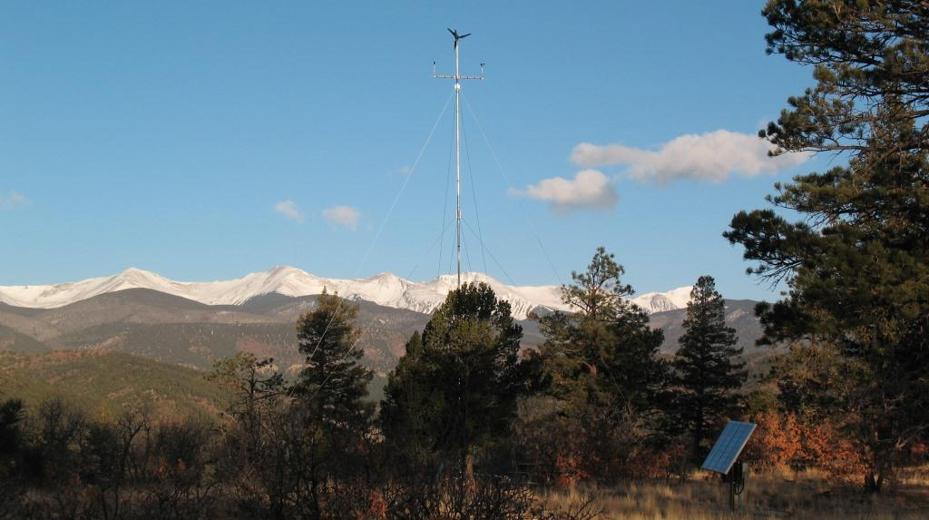
Wind Turbine Testing

Slide 2
Why Test?
Limited number of machines suitable for polar applications
Identify the good and bad machines
Identify the good and bad manufacturers
Gain familiarity with the systems
Decrease failure rates to promote greater project success

Slide 3
PFS-South Test Site
8,200’ elevation in southern Colorado
  Air density 20% less than sea level
Subject to very high wind speeds
Also (we know now) extreme turbulence
Fairly cold temps – but not polar cold
Accessibility: Ability to monitor in person and remotely
No difficult code or zoning issues
No permit required

Slide 4
The Testing Setup
50’ guyed, tilt-up type tower from SWWP provides economical system, easy to access turbine (about 15 - 20 minutes to lower)
Robust foundation and grounding system
2.5” schedule 40 pipe can handle up to 1kW machines
WLAN/broadband satellite communications
APRS World supplied monitoring system
Back-up solar (PV) system to keep batteries charged

Slide 5
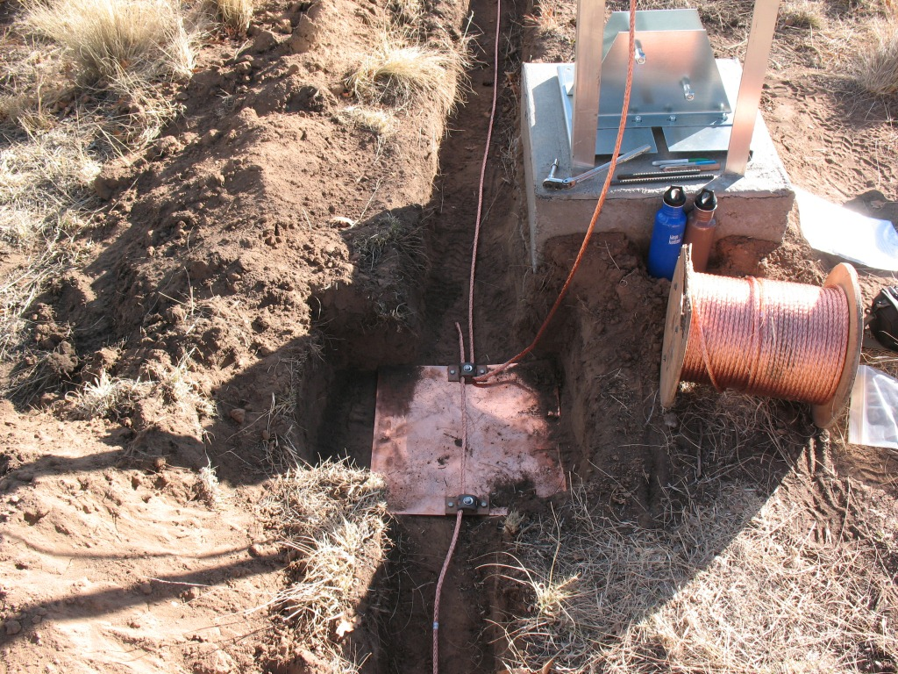
Earth Grounding Detail

Slide 6
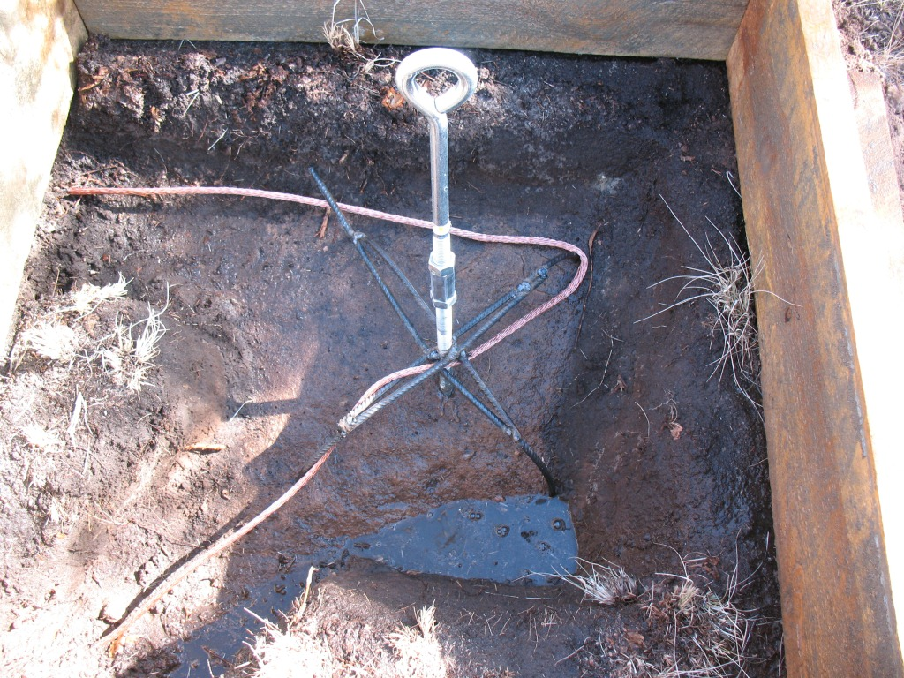
Foundation Detail

Slide 7
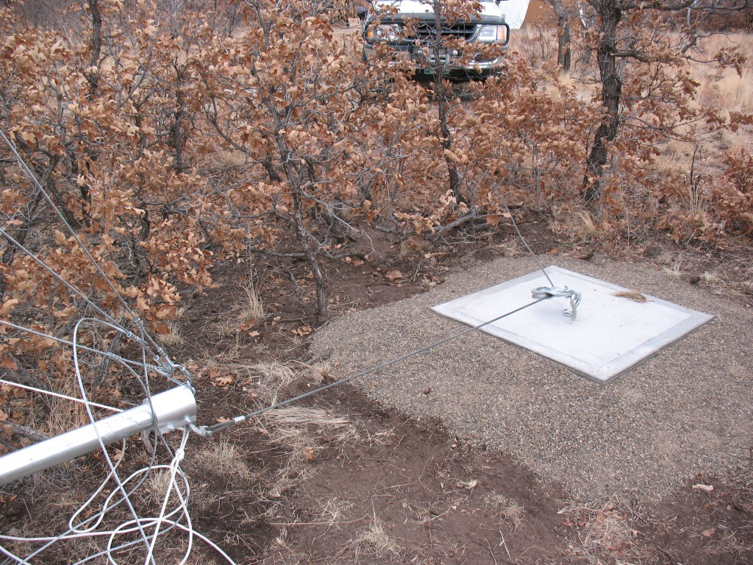
Raise/Lower System

Slide 8
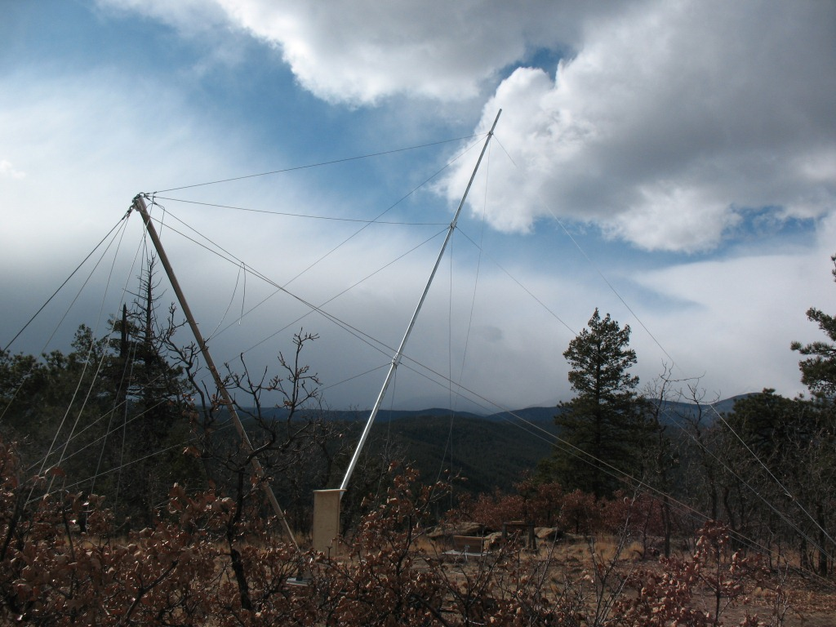
Initial Tower Raising

Slide 9
What Machine to Test?
APRS World - WT10/14
- Nicely balanced design
- Light yet powerful
- 3-Phase AC output from turbine
- Black finish
- Designed for fast field installation
- Reconfigurable for different wind regimes
- Initial discussions suggested an interested and engaged manufacturer

Slide 10
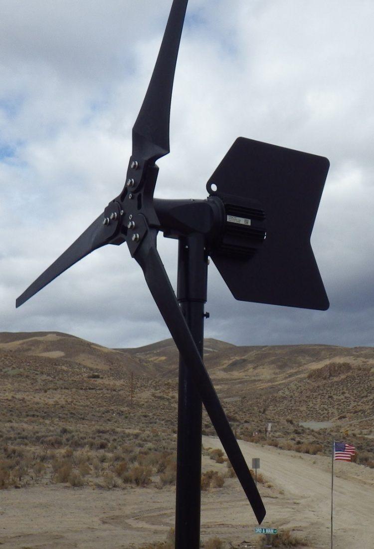
WT14 Wind Turbine
3 blades, horizontal axis, upwind
Rotor
  1.4 m (4.7 ft) rotor diameter
  Glass filled nylon blades
Generator
  Permanent magnet
  3∅
  Variable voltage and frequency
  1kW nominal capacity
11 kg (24 lbs) weight

Slide 11
WT14 Manufacturer Ratings
Battery charging 24 or 48 volt battery
  4.5 m/s (10 MPH): cut in speed
  5.4 m/s (12 MPH): 50 watts!
  13.5 m/s (30 MPH): 300 watts
  55 m/s (123 MPH): survival speed
“Optimized for power production in moderate wind regimes. Survives occasional intense high wind.”

Slide 12
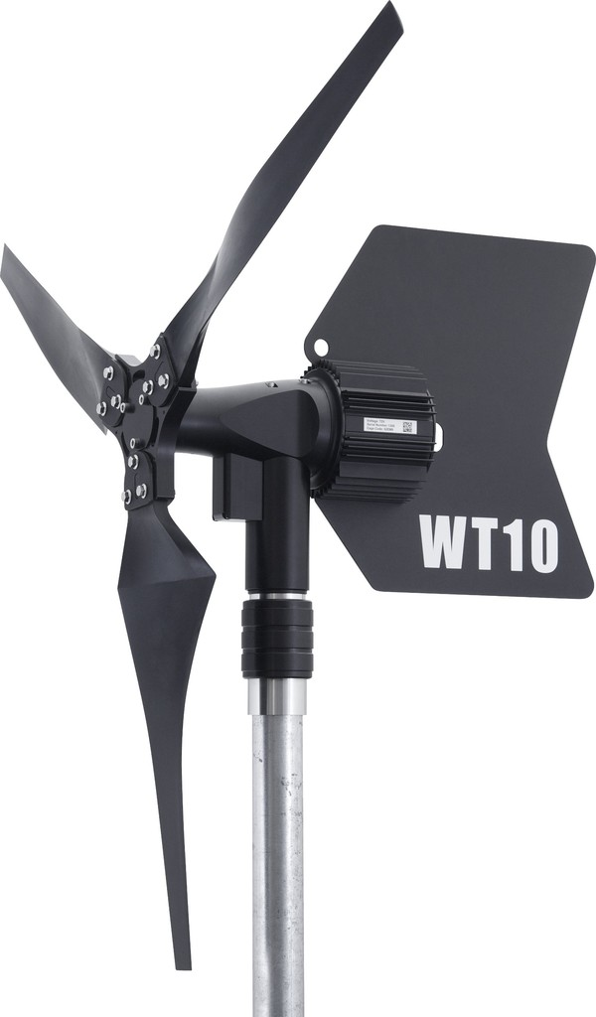
WT10 Wind Turbine
3 blades, horizontal axis, upwind
Rotor
  1.0 m (3.3 ft) rotor diameter
  Glass filled nylon blades
Generator
  Permanent magnet
  3∅
  Variable voltage and frequency
  1kW nominal capacity
10 kg (23 lbs) weight

Slide 13
WT10 Manufacturer Ratings
Battery charging 24 or 48 volt battery
  4.5 m/s (10 MPH): cut in speed
  13.5 m/s (30 MPH): ~300 watts
  31.5 m/s (70 MPH): ~750 watts
  >70 m/s (>157 MPH): survival speed
“Optimized for high wind energy sites.”

Slide 14
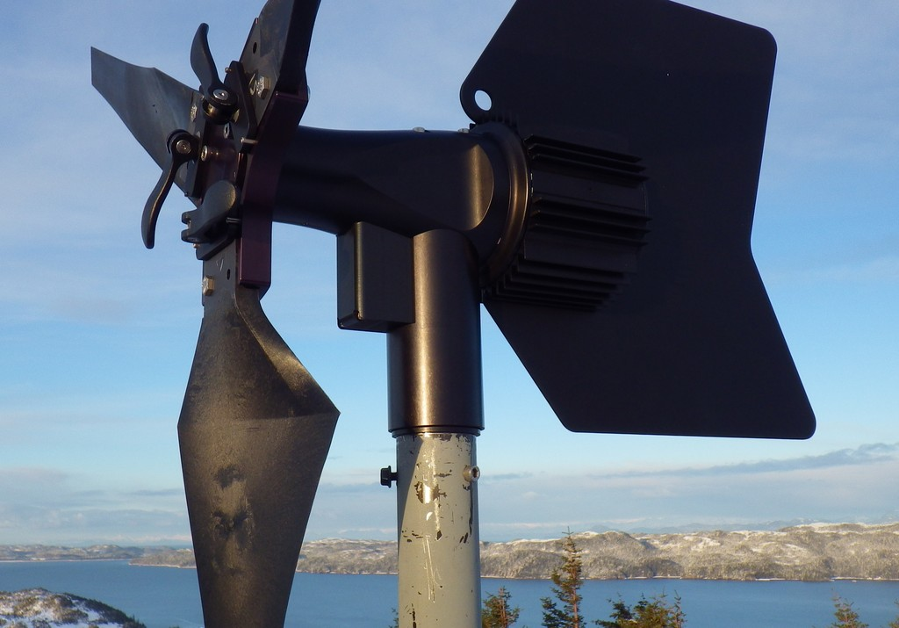
WTAPRS Polar Relevant Features
Light weight and compact
Installation
  Tool less assembly while wearing gloves
    Connectorized electrical (standard)
    Quick attach tail (standard)
    Quick attach blades (option)
    Quick attach to mast (option)
  Very quick installation
  Materials selected for resilience at low temperatures
  Easy to rig
    Carabineer hole for lifting
    Can be attached to harness and carried up tower

Slide 15
WTAPRS Polar Relevant Features (continued)
Operation
  Entirely sealed
    O-rings for chassis components
    Sealed bearings
  Black to promote ice melt
  Anodized aluminum and stainless steel hardware
  No electronics in turbine

Slide 16
Test Setup
Independent autonomous system
Charges 24 volt battery
Excess power is dumped to dump load
Turbine and meteorological data
  Logged to SD card
  Sent via 802.11b / Hughes to WorldData
  Sent via APRS World / SPOT Modem to WorldData

Slide 17
Test Setup – Meteorological Sensors
Meteorological Sensors
Turbine Sensors
Anemometer and wind vane
  At ~45ft up tower on sensor boom
Temperature
  At ~6ft on tower in solar radiation shield
  Enclosure temperature
IP Camera
  Turbine and top half of tower
Battery voltage
Turbine current
Turbine RPM
  Sensed from turbine wild AC
Dump load
  Duty cycle (% of available load)
  kWh dumped
  Battery temperature

Slide 18
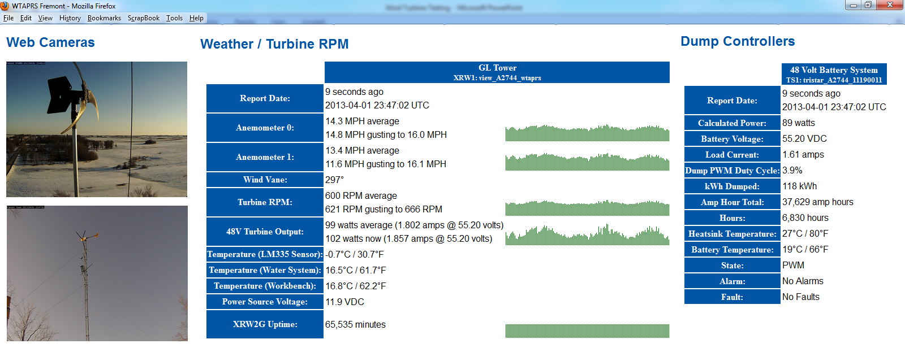
Live (Internet) Data Website
Note: This screenshot isn’t from Tracy’s PFS site due to internet bandwidth limitations.
This is a test unit in Minnesota. Live data at:
http://data.aprsworld.com/sites/wtaprs/fremont/

Slide 19
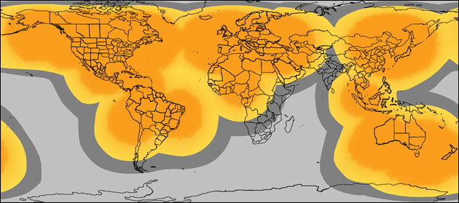
Telemetry - Satellite
APRS World / SPOT Satellite Telemetry
  Globalstar network
  Low cost SPOT network
  <$400 hardware & <$100 year data
  6 hour highly compressed message with
    Wind speed / gust / average
    Turbine RPM / average RPM / current
    Temperature
    Dump Load kWh, duty cycle, battery temperature
    Battery Voltage

Slide 20
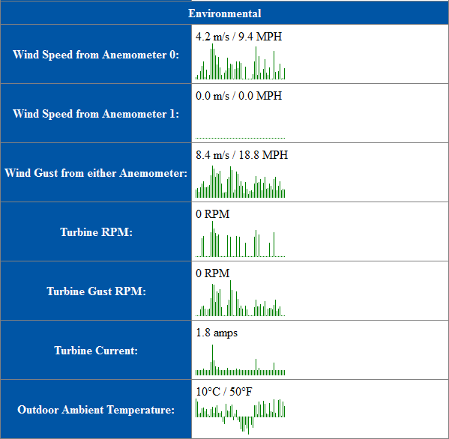
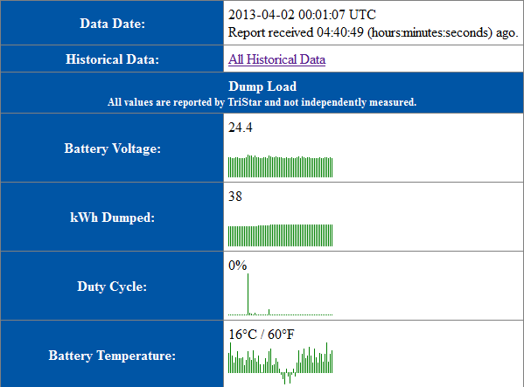
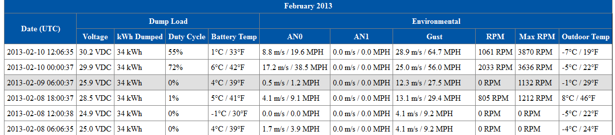
Satellite Telemetry Data Website
Example of “live” data:
Example of historical data:

Slide 21
WT14 @ PFS-South
Installed 2012-11-25
Instrumentation not completely commissioned
Produced energy, lots of it
  ~45 kWh total production to 2013-01-11
Wind events
  Anemometer not connected
  RPM data implies multiple storms

Slide 22

WT14 Failure 1 @ PFS-South on January 11, 2013
Problems
  Internal permanent magnet generator failure
    Rotor became detached from main shaft
  Hub / main bearing interference
    Rotating part wore and came in contact with non-moving nose of turbine
  Yaw
    Turbine would yaw 360° in high winds
Video of turbine yaw in high winds: http://youtu.be/LIp3uZJ5oC8

Slide 23
WT14 Failure 1 Causes:
Permanent Magnet Generator Failure
Known weakness in design of rotor to shaft interface
  Manufacturer is beginning to manufacture improved design with multiple rotor to shaft retention features
Manufacturer attributes to wind event exceeding ratings of turbine and exasperating known design weakness

Slide 24
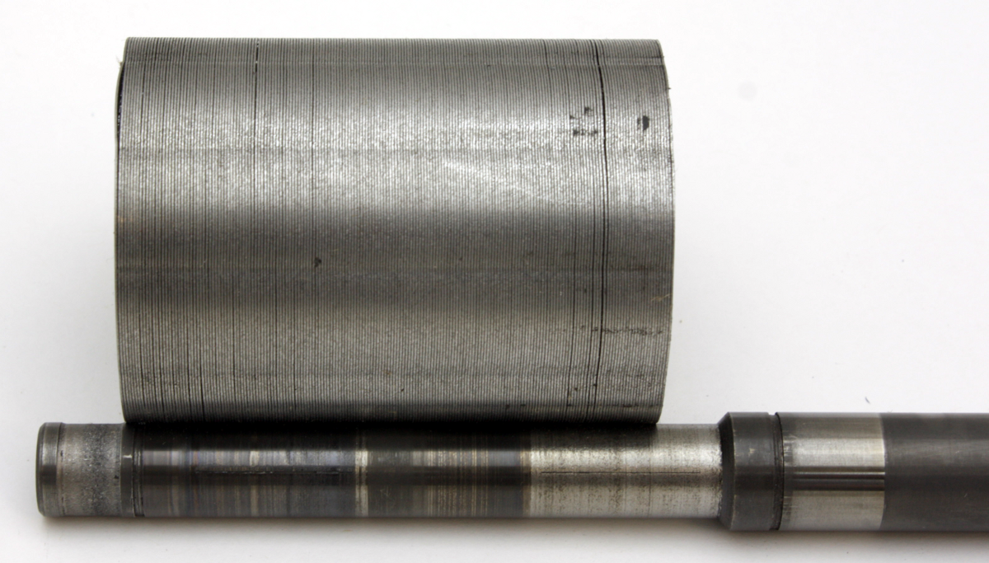
Failed Rotor / Shaft

Slide 25

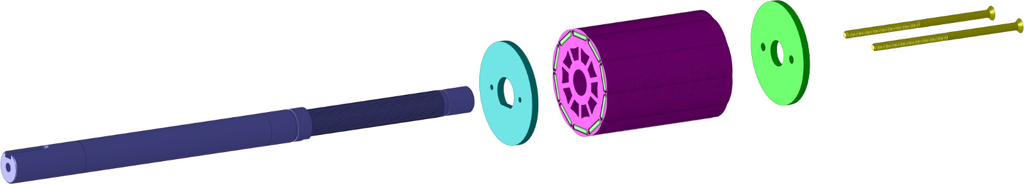
PMG Rotor Shaft Detail
Original Design (what failed)
Revised design (what won’t fail)

Slide 26
WT14 Failure 1 Causes:
Hub / Main Bearing Interference
Defect in design
  Previous generations had much larger gap between rotating hub and fixed body
  Smaller gap adopted to minimize area for ice accumulation
  Wear in component allowed surfaces to rub
Manufacturer attributes to design defect and premature failure caused by excessive turbulence in high winds.

Slide 27
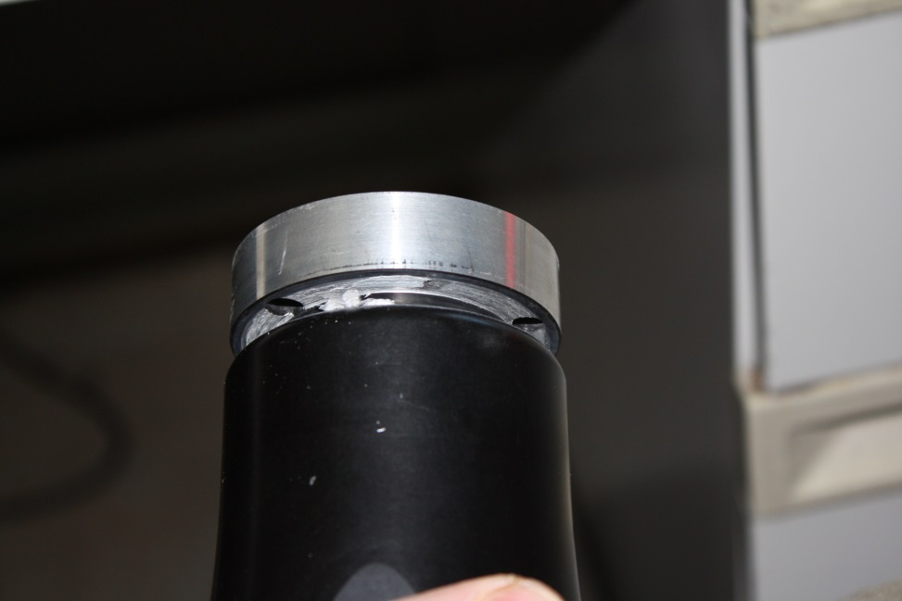
Hub / Main Bearing Photo

Slide 28
WT14 Failure 1 Causes:
Excessive yaw
Intrinsic to design of high speed wind turbine
  Similar behavior documented in many other small high speed wind turbines
Larger tail was installed
  Appeared to stabilize the machine – up to a point
Manufacture argues that excessive yaw is due to site turbulence
- WT10 has not exhibited yaw instability
  Air-X wind turbine exhibiting the same yaw behavior: http://youtu.be/5ilfsqQAULE

Slide 29
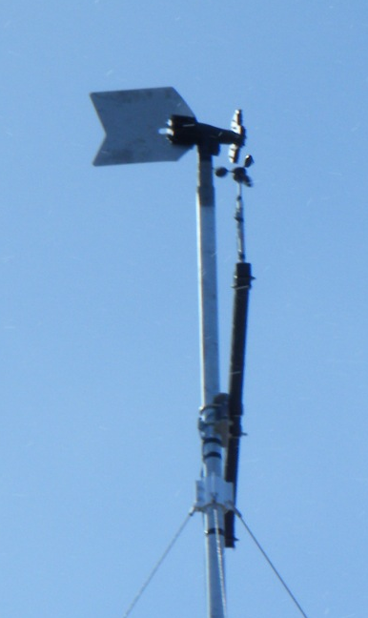
WT14 Failure 2 @
PFS-South on 2013-03-04
Turbine failure in high wind 40 m/s (90 MPH) event
  Loss of blades
    All three blades broke at root
    Root of blades remained bolted to hub
  Bent tail
    ~15 degree bend in PROTOTYPE larger tail

Slide 30
WT14 Failure 2 Causes:
Loss of Blades
Hypothesis: Blade injection molding process / mold design causes weak spot at location where blades failed
High wind events / rotor over-speed stress the blades and caused failure
Manufacturer is modifying injection molding tooling to eliminate week spot around hold in blade
Manufacturer attributes failure to turbine exceeding survival speed and design defect in blade tool.
  Induced blade failure test by manufacturer: https://www.youtube.com/watch?v=riGjq9Arlec

Slide 31
WT14 Failure 2 Causes:
Bent Tail
Damage to turbine housing where tail installs indicates large motion in tail.
Likely caused by unbalanced momentary operation of the turbine with 1 or 2 blades.
Note: This was a prototype tail that is larger than production WT14 tail. Increased size has larger moment and may exceed yield strength of material.

Slide 32
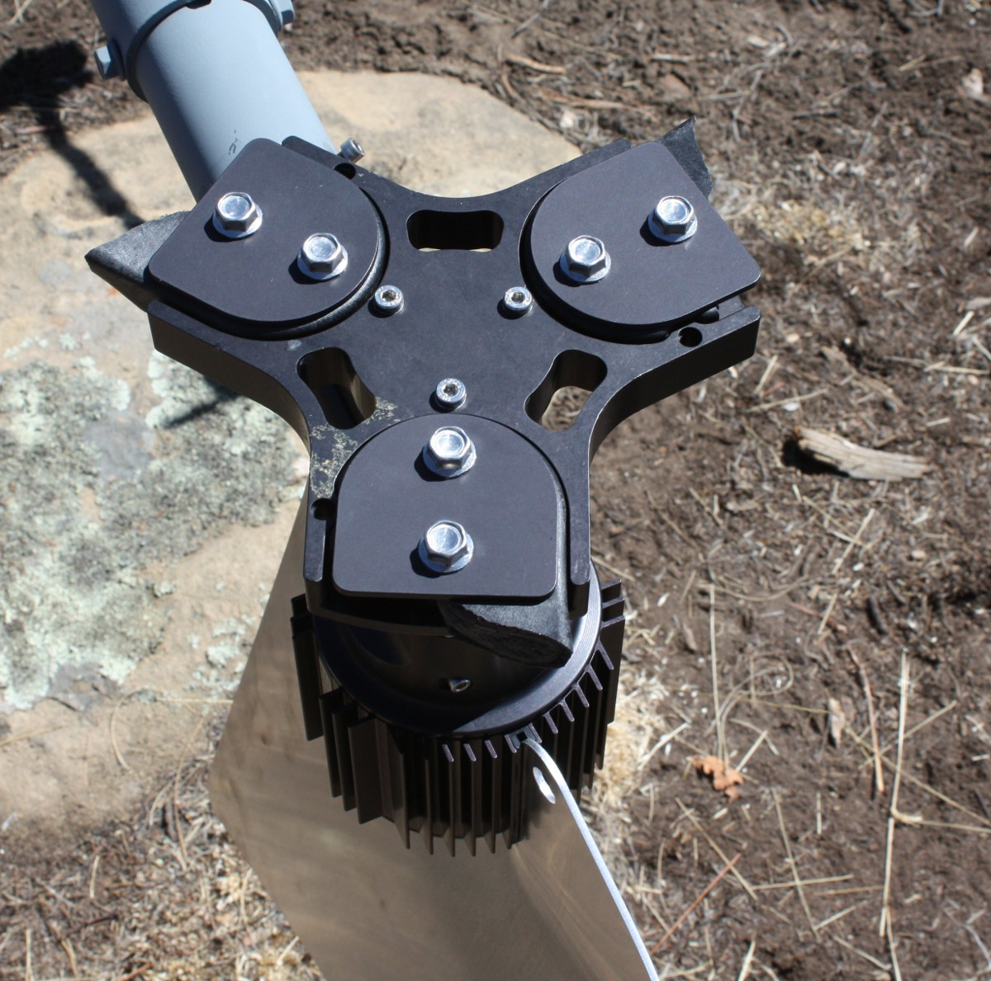
WT14 Failed Blade and Tail

Slide 33
Tracy’s WT14 Observations
Excellent low speed (12 mph)to mid speed (40 mph) wind performance
Loud and scary in high wind (>50 mph)
> 100dBA @ 70+ mph wind speeds
Not currently suitable for use in high wind areas
  Design improvements may help
Not good for turbulent wind!

Slide 34
WT10 @ PFS South
Installed 2013-03-12

Slide 36
WT10 Observations
Quiet operation
Higher starting speed
Stable operation

Slide 37
Conclusions
Testing has been mutually beneficial
WT10 is a solid performer for high speed/turbulent wind regimes, but may not be optimal for lower wind speed areas like North Slope
WT14 performs very well at low to moderate speeds, but cannot (currently) withstand prolonged high/turbulent winds

Slide 38
Conclusions Continued
The basic APRS World design is solid, continually improving and suitable for polar applications.
The ability to reconfigure for different wind regimes seems like a very desirable feature.
Very cold weather performance not yet qualified, but should be good.
Possibility for polar extreme model (e.g., ceramic bearings)??
Great to work with a willing and engaged manufacturer.
  APRS World is looking for looking for polar testing oprotunities

Slide 39


Questions and Comments?
Tracy Dahl
  Polar Field Services, Inc.
  Tracy@Polarfield.com
  303.518.8713
James Jarvis
  APRS World, LLC
  jj@aprsworld.com
  507.454.2727
Information on the WT10 and WT14 at:
http://www.aprsworld.com/wtaprs/

