Slide 1
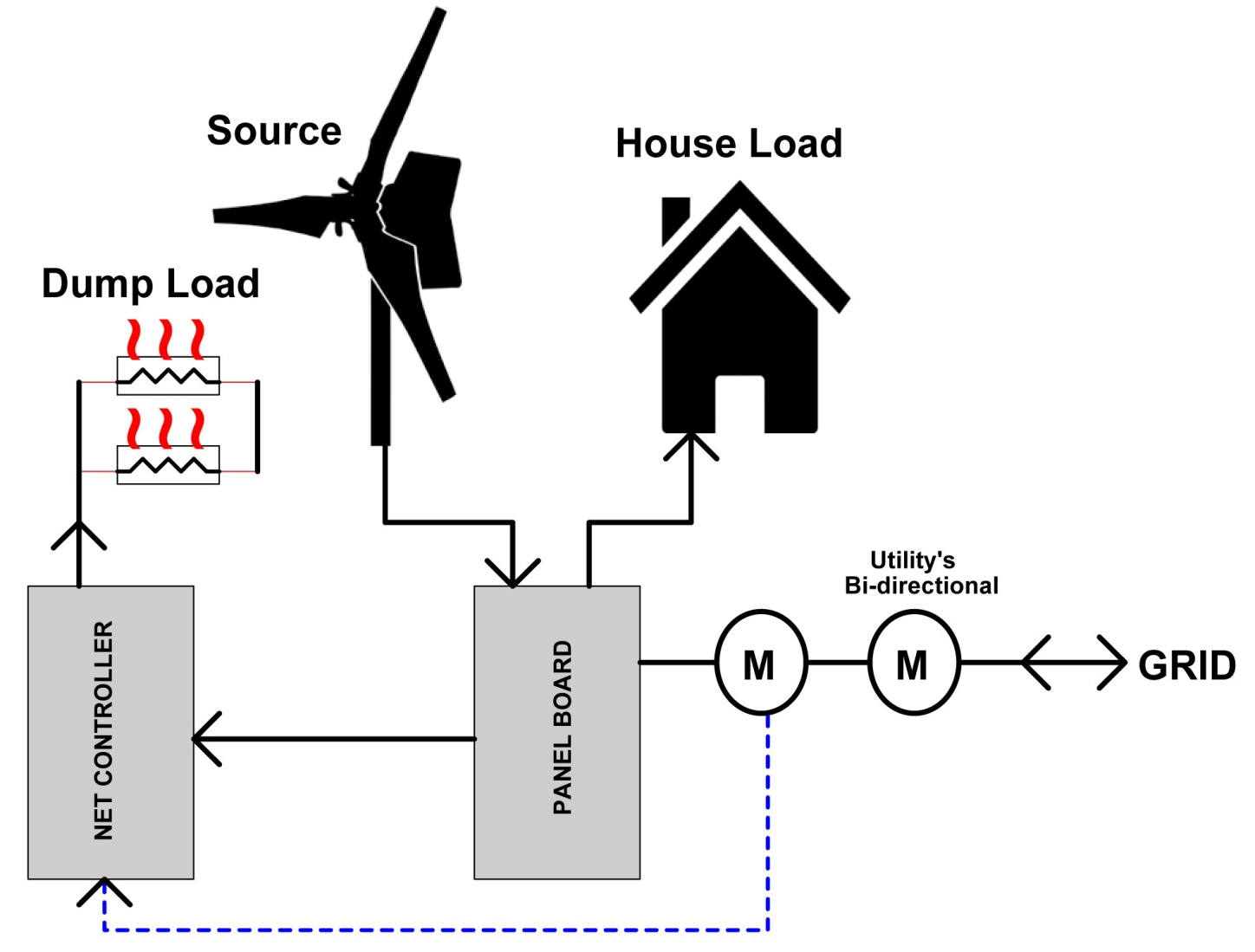
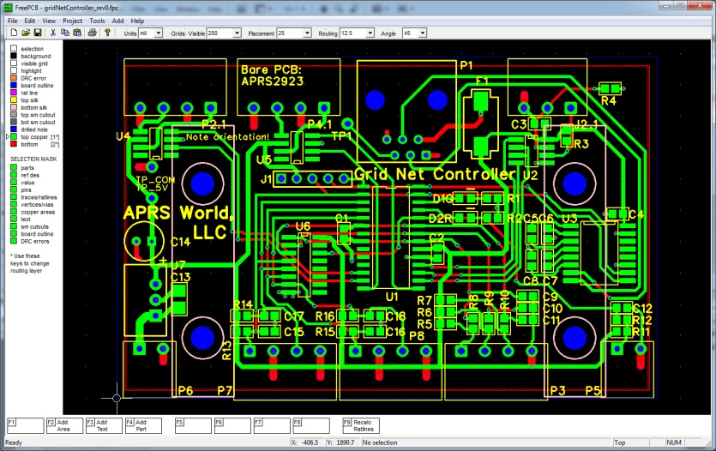
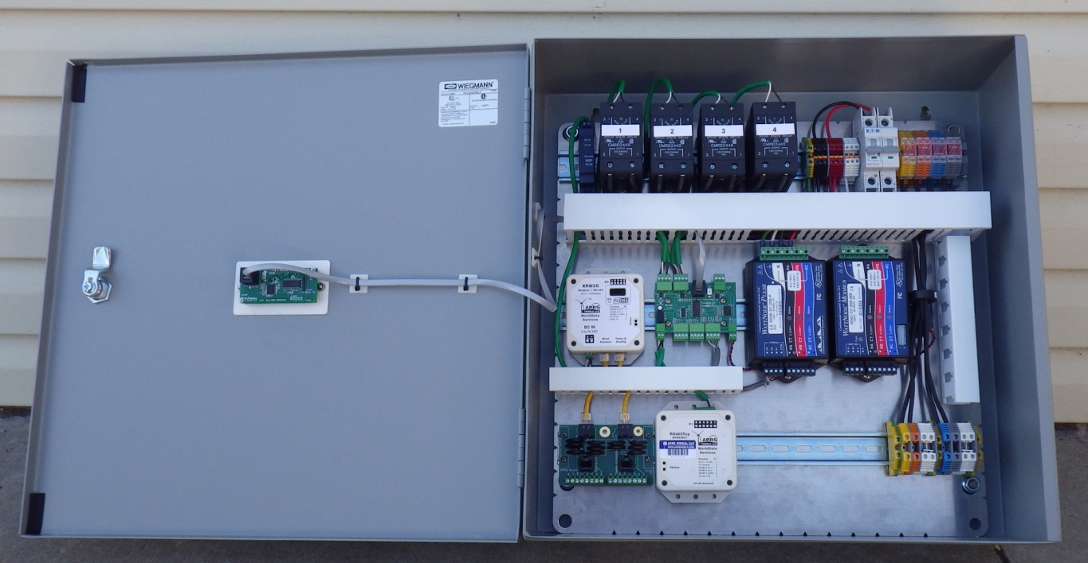
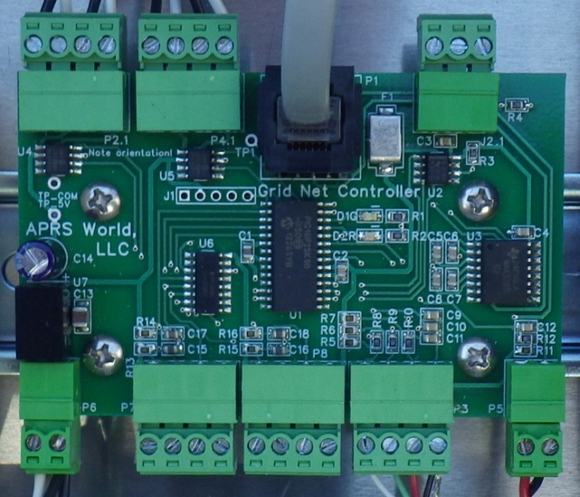
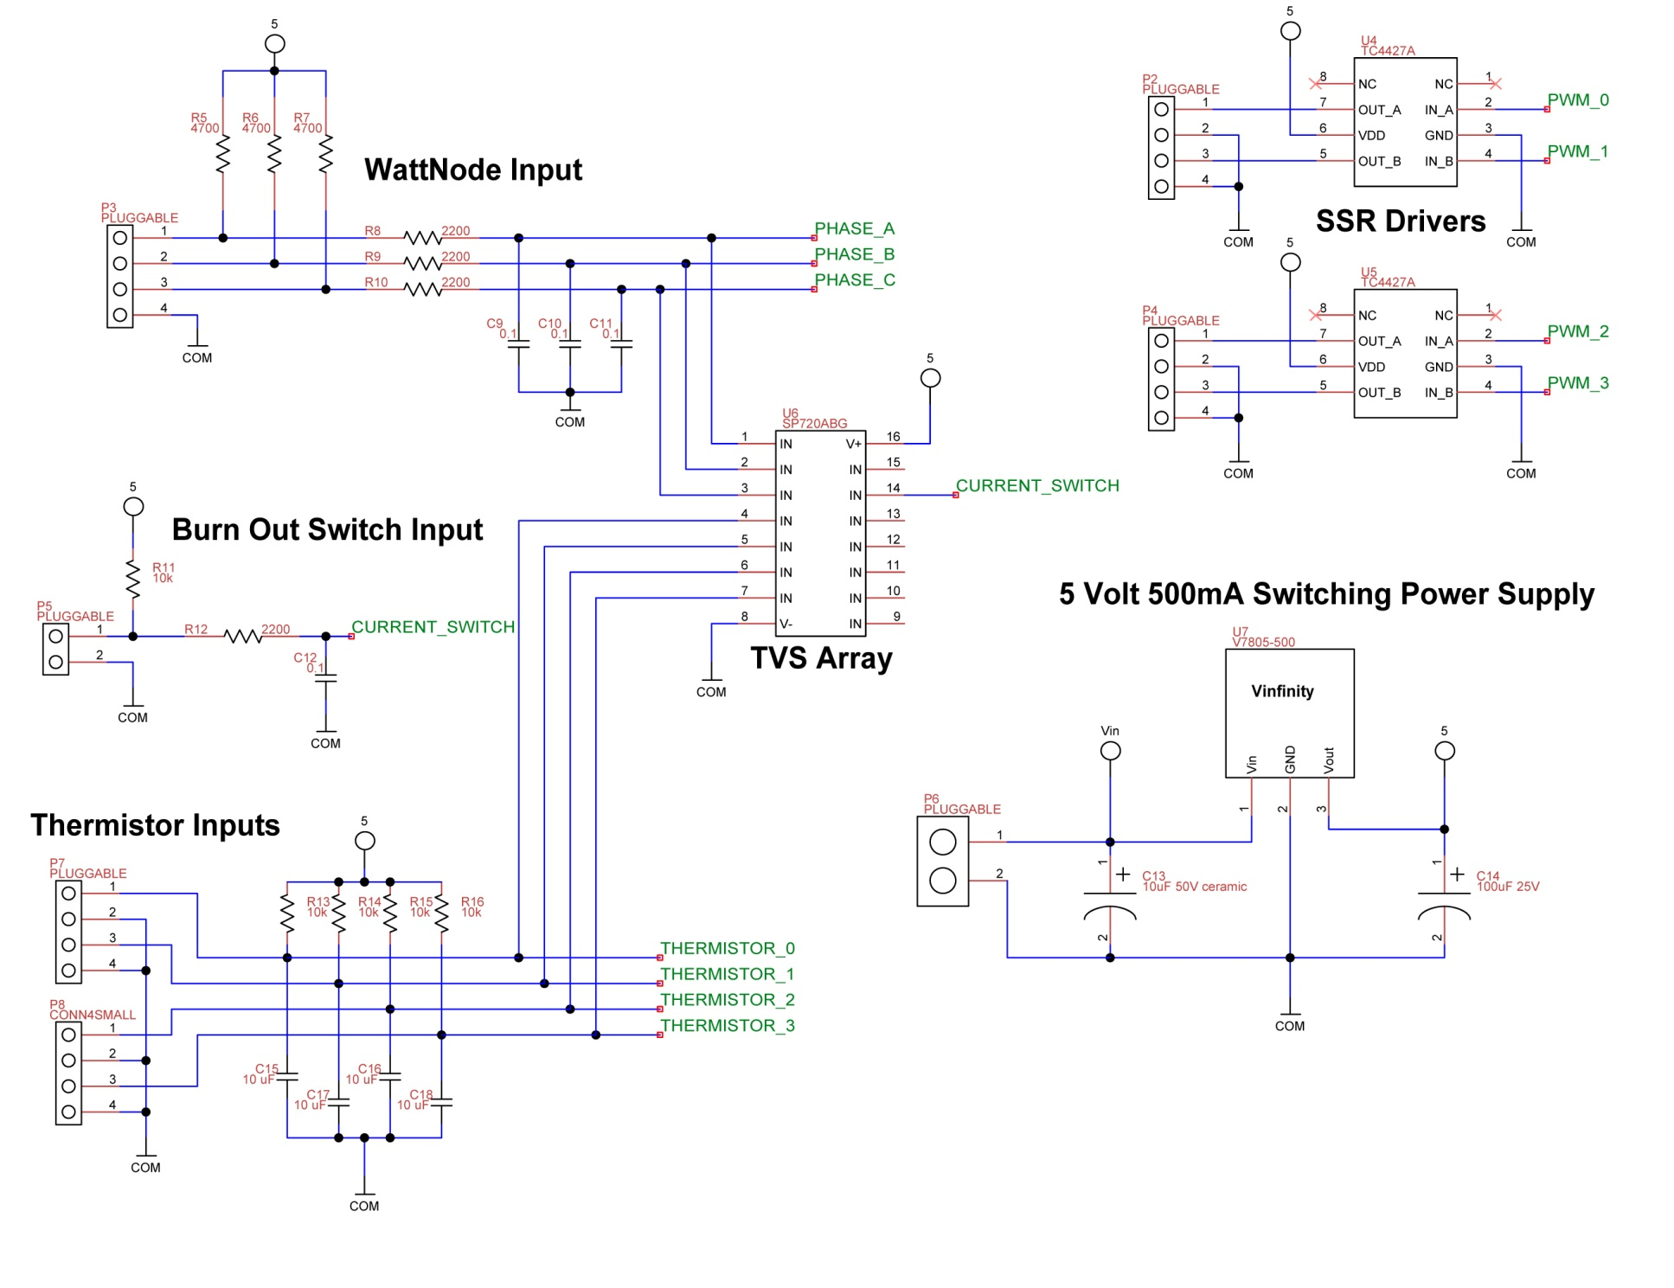
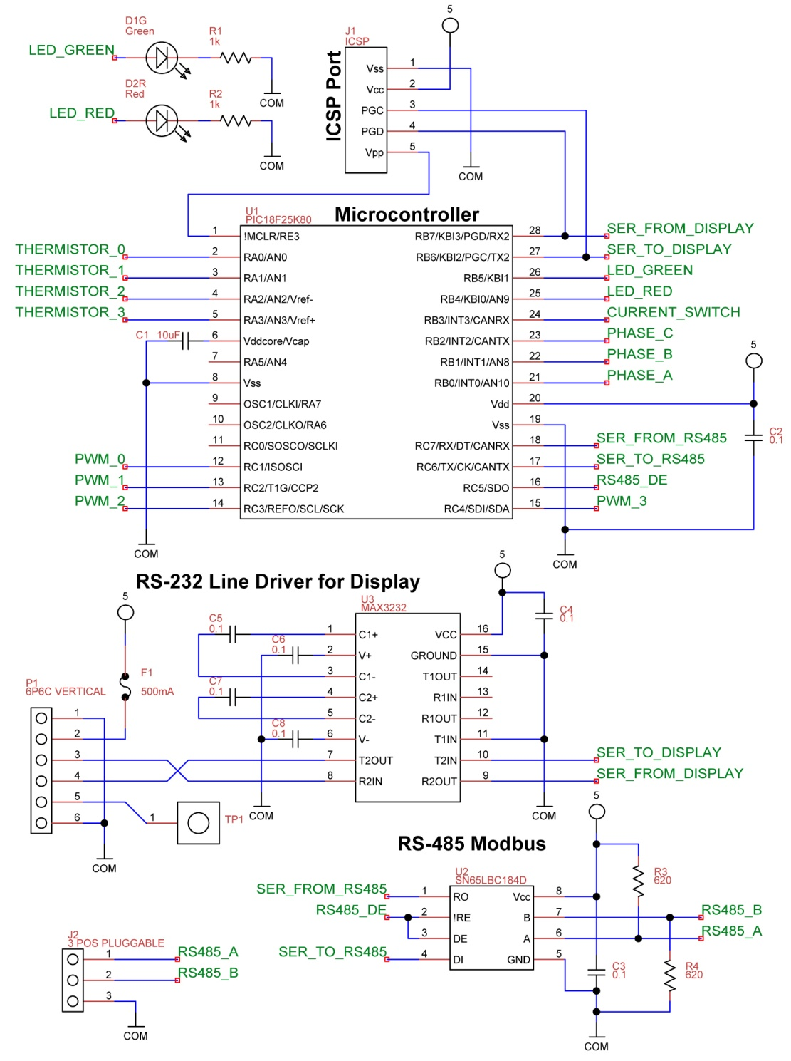
Load Control System for Minimizing Export with Grid Tied Renewables
James Jefferson Jarvis
jj@aprsworld.com
Introduction:
With fast and intelligent control of onsite loads, the energy generated by renewables can be used locally instead of delivered to the utility grid. In some jurisdictions exporting energy to grid is permitted, however the producer is not compensated for this energy. In these cases it makes sense to store or use the energy locally. This poster provides an introduction to the grid export controller that APRS World is designing and testing. It is called, creatively enough, the “Grid Net Controller.”
How it works:
The Grid Net Controller continuously monitors at the utility interconnection point for power being exported to the grid. When power export is detected, the controller gradually turns on water heating dump loads until the exported power becomes negligibly small. When no power export is detected, the controller gradually reduces the amount of power dumped until a tiny bit of power is being exported again or the dump load is completely off. This process repeats itself 5 times per second. These continuous adjustments mean that the power delivered to the dump load varies as the power generated by the renewable source and the power consumed by the household vary.
Test Site and Setup:
APRS World's Fremont, MN small wind test site is being used for development and testing of the Grid Net Controller. Our Fremont site has a 12kW Bergey Excel wind turbine on a 120' guyed lattice tower. A revenue grade meter, data collection hardware, and remote data access are installed at the site so that we can measure energy produced by the turbine and energy exported or purchased from the grid. Air conditioning, electric heat, deep well pump, food prep, and other on site loads are typical of a residence and will provide a load regime similar to the intended application. A wind turbine makes the ideal grid connected source for testing because the output of the small wind turbine typically varies much faster than a renewable source like solar or hydro.
Our Fremont test site does not have a big demand for heated water, so we have designed and fabricated a simple 55 gallon steel tank with no insulation. All heat gets conducted to atmosphere. The tank is comprised of a 55 gallon drum with four 1” NPSC bungs welded in for heating elements and four ½” NPT bungs welded in for temperature sensors. Water is currently filled manually.
Hypothetical day with and without Grid Net Controller:
• Wind turbine generates 7.5kW for first ½ of day, and 1kW for second ½ of day
• Utility does not pay for exported power, but charges $0.25 per kWh bought
• House needs continuous 2kW (48kWh per day) of hot water for space heating and can store 100kWh of hot water in tank
Result with no export controller:
• First ½ of day: (7.5kW generated – 2kW hot water load) * 12 hours = 66kWh ($16.50) given to utility
• Second ½ of day: (1kW generated – 2kW hot water load) * 12 hours = 12kWh ($3) purchased from utility
Results for the day:
• $3 total electric bill
• 66kWh ($16.50) given to utility
• Tomorrow you get to do it again
Result with export controller
• First ½ of day: (7.5kW generated – 7.25kW delivered to hot water tank) * 12 hours = 3kWh ($0.75) given to utility, 24 kWh used to heat house, and 63 kWh heat added to storage tank
• Second ½ of day: 12kWh heat used from tank, 12 kWh heat used directly from turbine power
Results for the day:
• $0 total electric bill
• 3kWh ($0.75) given to utility
• 51kWh ($12.75) – more than 1 day of hot water added to storage tank!
Results to date
2013-05-29: Circuits designed, printed circuit boards laid out
2013-06-07: First article circuit boards received and built
2013-06-09: Microcontroller operating, communicating via Modbus, reading all sensors inputs, and controlling all load outputs
2013-06-10: Grid Net Controller control panel wired
2013-06-11: Electrical upgrades to APRS World lab to accommodate full power operation
2013-06-12: Test tank fabricated and wired
2013-06-12: Full and partial power testing to evaluate thermal management needed for panel. It appears that a fan will be required in the enclosure.
Ongoing: Control algorithms have been developed, simulated on PC, and implemented on microcontroller
Test tank with four 3kW water heating elements with yellow cords, and four temperature sensors with green cords.
Right side (door): White piece is an LCD display for local viewing of status and diagnostics.
Left side: Solid state relays and power distribution on top row. XRW2G sensor input module for meteorological and flow sensors, control board, and power / energy meters on middle row. And a RSTap internet gateway for remote monitoring on bottom row.
Technical details:
Circuit board in layout software and
assembled board in real life.
Load Control:
Cost effective load control is one area that APRS World is experimenting with for our Grid Net Controller. To respond to the changing house load and renewable supply, the controller must be able to quickly vary the amount of power being dumped to each of the heating elements. Typical water heating applications use a very slow on/off control of the heating elements. This is not fast enough for our application and does not allow varying levels of power to be dumped. Our initial design uses “Burst Firing” modulation of the dump loads.
Burst Firing
Burst firing repeatedly turns on and off full AC wave cycles. The percentage of on cycles to off cycles is the average amount of power delivered to the load. The graph above shows an example where the load is connected for two out of ten cycles. This results in an average of 20% power being delivered over the time period of 10 cycles. Longer number of cycles in the burst window allows greater resolution in power control, but this results in a longer averaging period. If the length of the burst window is close to or greater than the utilities’ meter, it may result in that meter measuring full load rather than the desired average.
Phase Delayed Firing
Phase delayed firing uses switching elements that can be turned on part of the way into the AC cycle. With accurate timing, a very precise output power can be set. Because phase delayed firing works on a cycle by cycle basis, the average power is controlled in one AC cycle, unlike the many AC cycles required by burst firing. The down side of phase delayed firing is that it requires more expensive switching devices and related drive circuitry. If we are not able to get enough resolution or fast enough response with burst firing, APRS World will move to phase delayed firing.
Schematic (rev0)

