Slide 1
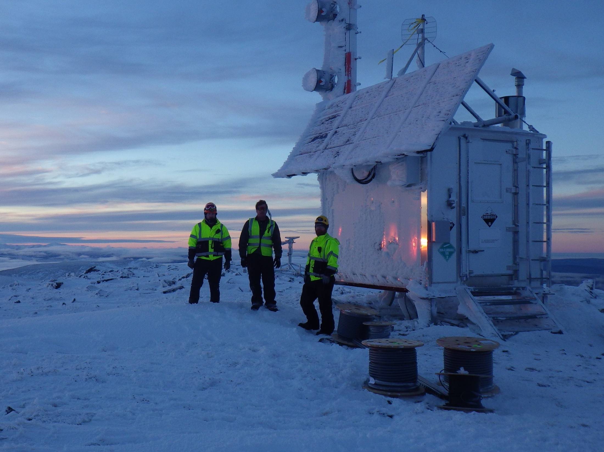
Micro Wind for Remote Sites
James Jarvis
APRS World, LLC
jj@aprsworld.com
+1-507-454-2727

Slide 2
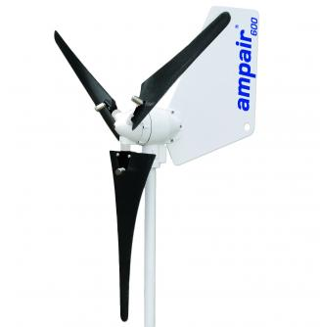
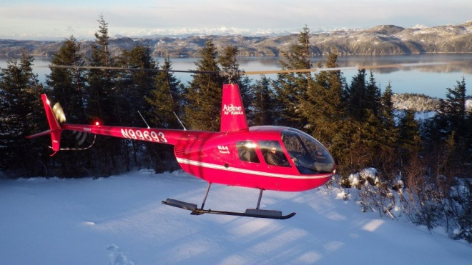
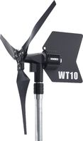
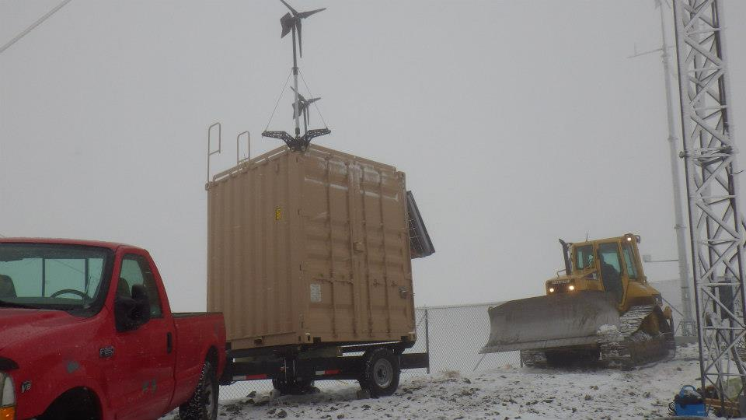
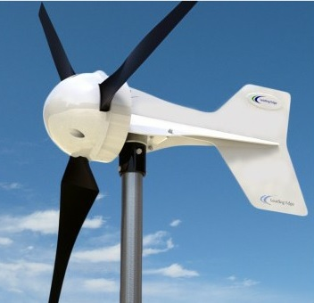
My Definitions
Micro Wind
Remote Sites
1,000 watts or less nominal power output
Inconvenient to access locations

Slide 3
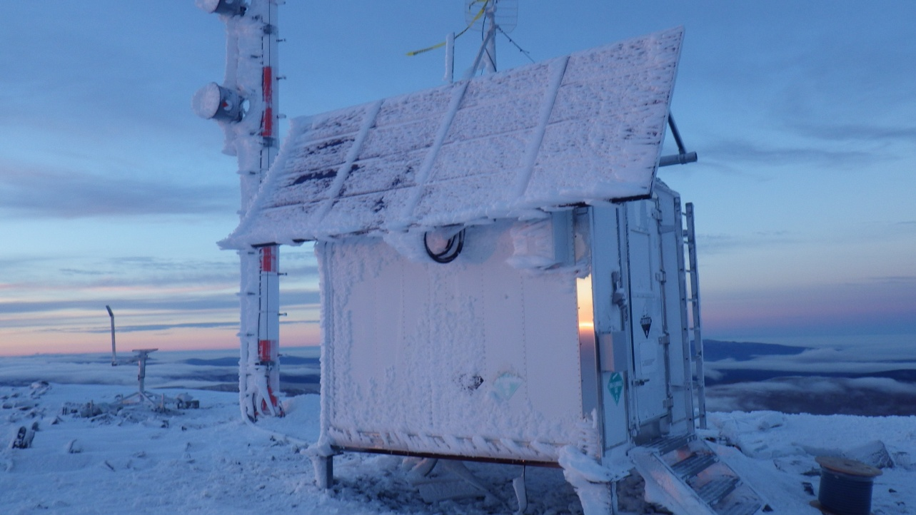
Keys to Success: Use Solar
Solar!
Reliable
Cheap
Easy
Use wind when you can’t get enough solar

Slide 4
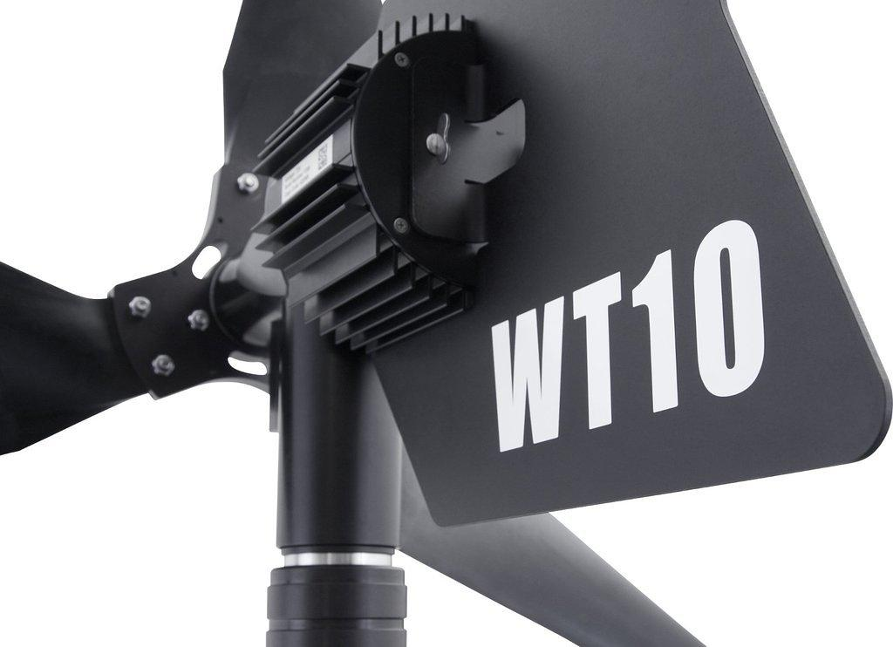
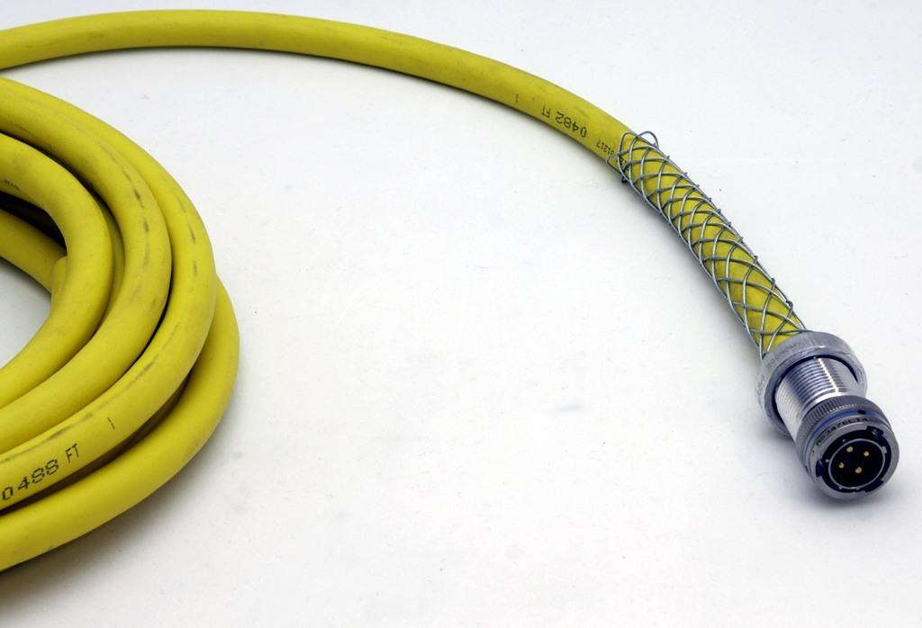
Keys to Success: Quality
Buy darn good stuff
Purchase price is always going to be cheaper than service cost or downtime

Slide 5
Keys to Success: Plan for Stuff to Break
Design with redundancy
but not the same components that break the same!
Minimize single points of failure
Don’t go overboard!

Slide 6
Keys to Success: Die Gracefully
When everything fails, don’t destroy the battery bank
Always incorporate low voltage disconnects
Keep LVD power consumption ≈ battery self discharge rate

Slide 7
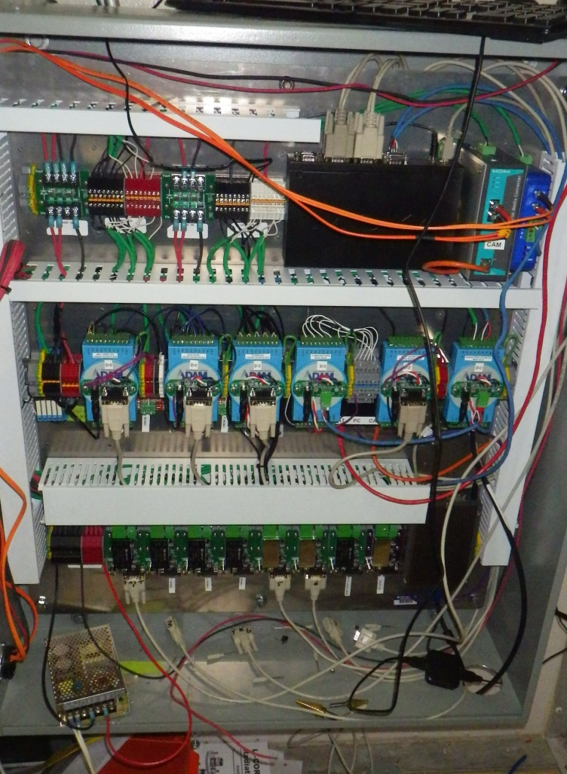
Keys to Success: Keep an eye on things
Monitor
system
environment
but don’t go overboard
Maintain
do preventative maintenance

Slide 8
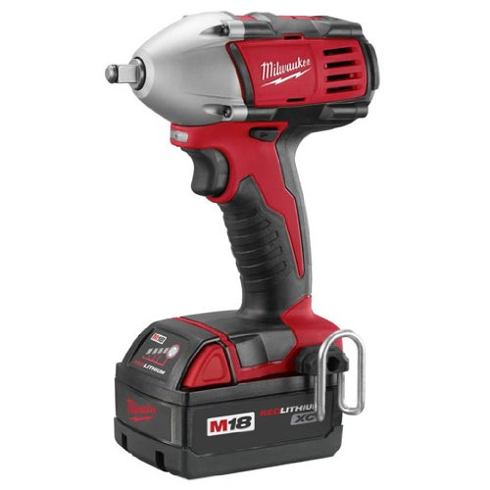
Keys to Success: Design for Installation & Maintenance
Minimize field time
Keep records
Bring the correct tools

Slide 9
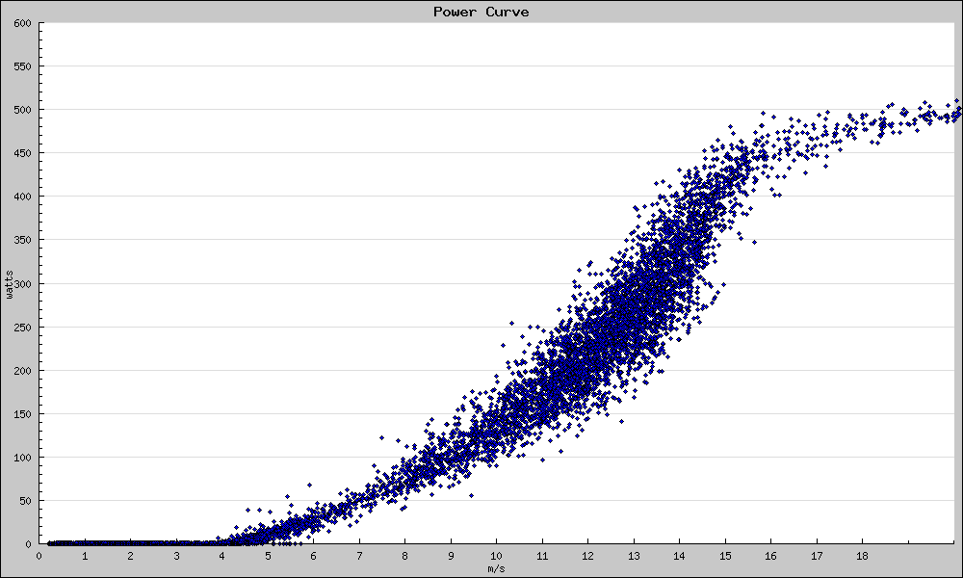
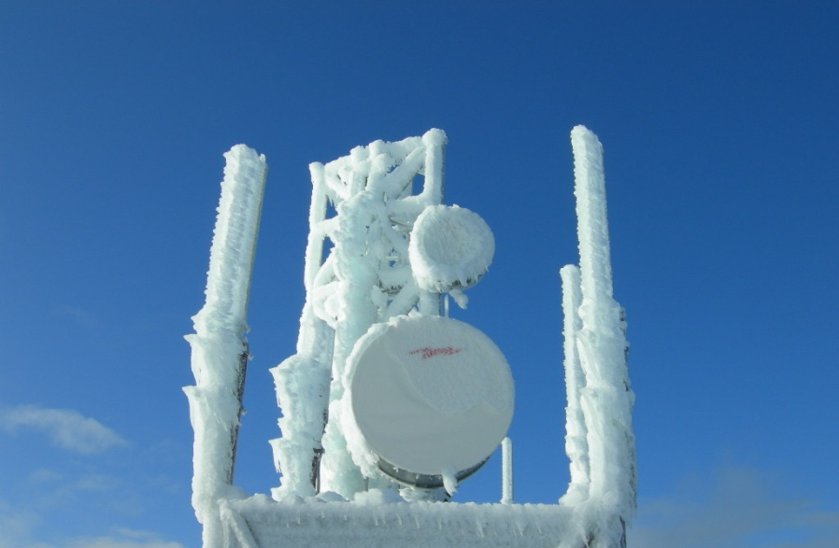
10 Second Technical: Turbine Selection
Site wind speeds versus cut-out speeds
be sure to look at all time periods, not just annual averages
Icing, salt water, extreme temperatures, etc
Keep active electronics out of the turbine!

Slide 10
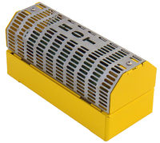
10 Second Technical: Make Use of Excess Power
Indoor dump load and outdoor dump load
Heat building when needed
Satisfy redundant dump controller requirements
Intelligent load control
turn on heaters, compress air, fill water tanks, upload data, etc
add useful loads
generator block & fuel
battery bank

Slide 11
Design for Transportation
Select economically transportable components
Observe ATV, snow machine, helicopter, etc weight and size limits
If at all possible, use your customer’s normal modes of site access.

Slide 12
Work in the easiest place possible
Pre-build as much as you can in your shop
sub assemblies, wire harnesses, anything that requires small parts
select vendors that make easy to install products!
Re-package parts and assemblies so they are easiest to handle in the field
packing peanuts or shredded paper at a wind site?
On-site time is the most expensive time

Slide 13
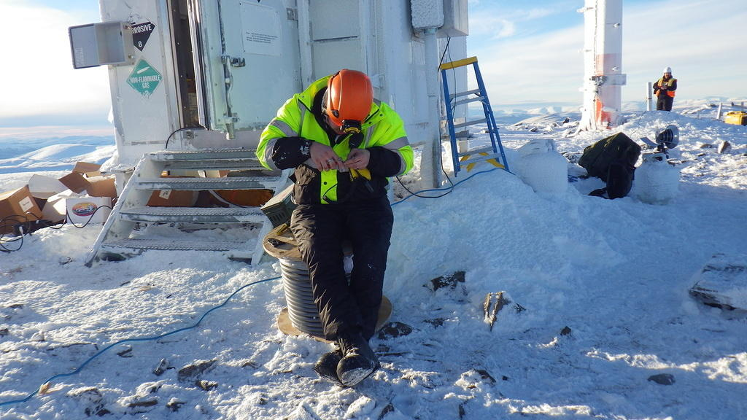
This is no fun at 0°

Slide 14
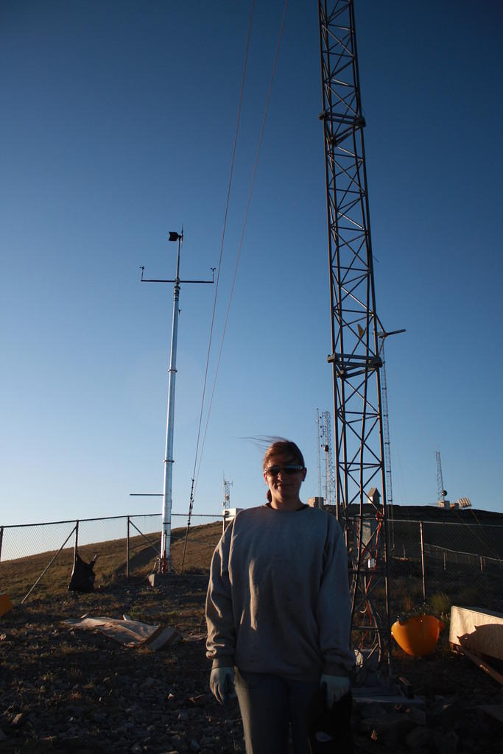
More Tower? More Power? More $$$?
Unique sites and unique considerations!
What is wind shear coefficient here?

Slide 15
10 Second Technical: Towers
Tower and foundation cost typically 2 to 10 times price of turbine
Install time typically 20 to 100 times the install time of the turbine
Consider mounting to existing towers or even roof mounting
Optimize your tower selection!

Slide 16
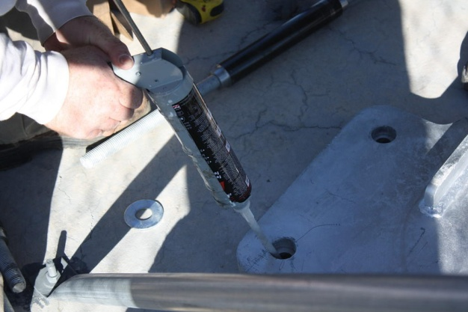
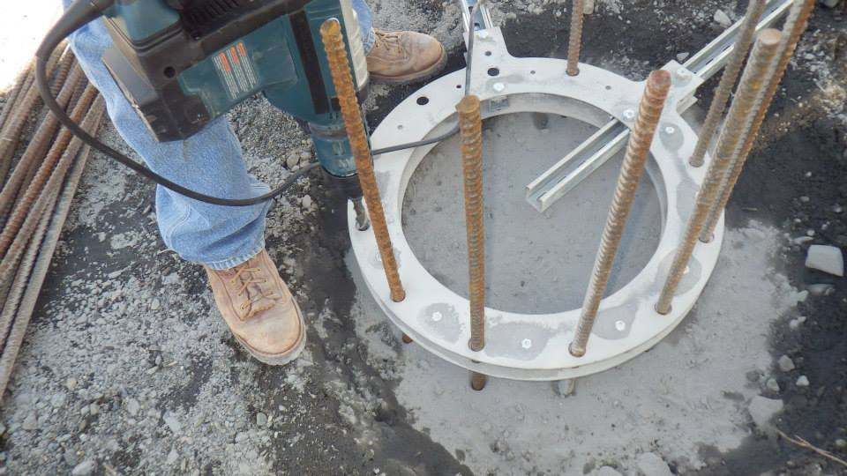
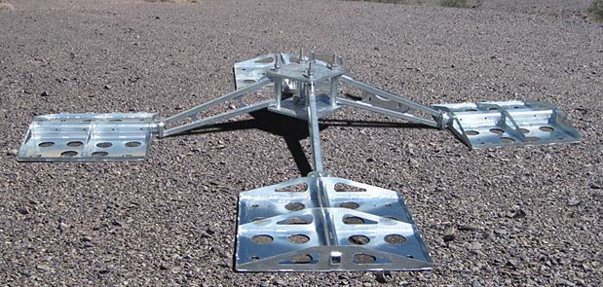
10 Second Technical: Foundations
Use what the site already has!
anchor to existing concrete slabs or rock
acrylic adhesive is my favorite
Consolidate available site materials into ballast for ballasted tower
rocks in a super sack
but do some math first

Slide 17
10 Second Technical: Controller Interactions
Make sure multiple charge sources aren’t fighting
don’t allow fossil fuel generator to trigger wind dump load
don’t dump while equalizing

Slide 18
10 Second Technical: Low voltage disconnects: use them!
Use low voltage disconnects to prevent damage to your batteries in the event of power source failure
Some turbines require no standby power and can be used to bring up a discharged battery
Turbines with MPPT or other active controllers typically require battery power to operate and cannot charge a discharged battery.
make provisions for some other source to be able to bootstrap things

Slide 19
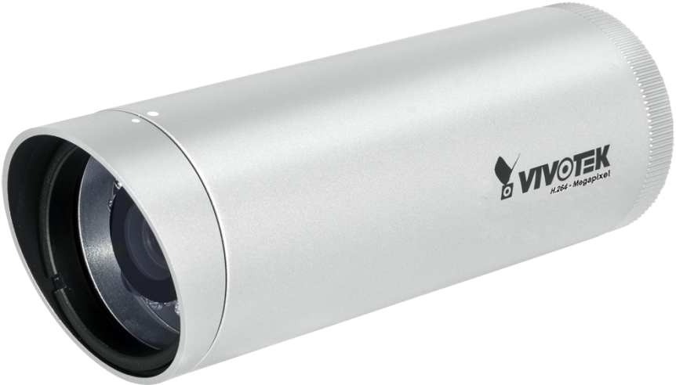
10 Second Technical: Telemetry
Put remote monitoring provisions into your system
Basic state of health data as minimum
Consider “web” IP camera view of turbine and PV
decent quality outdoor web cameras are now <$500

Slide 20
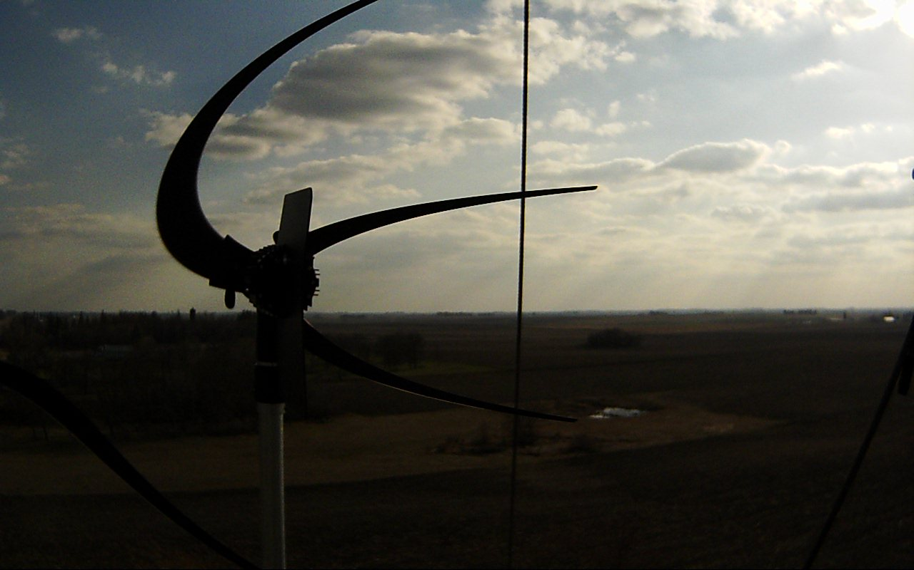
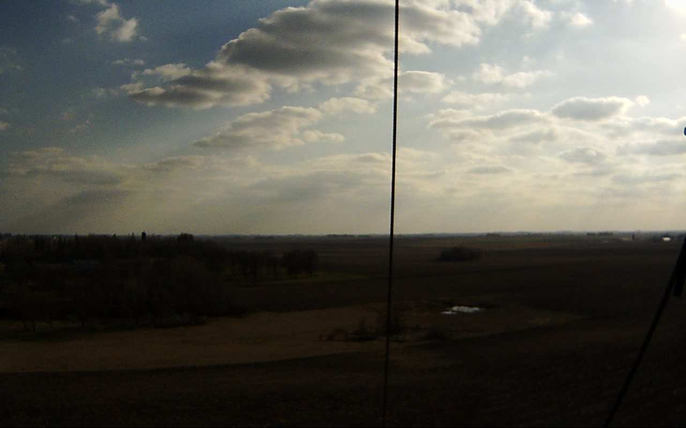
IP Camera Example
6:09PM
6:10PM

Slide 21
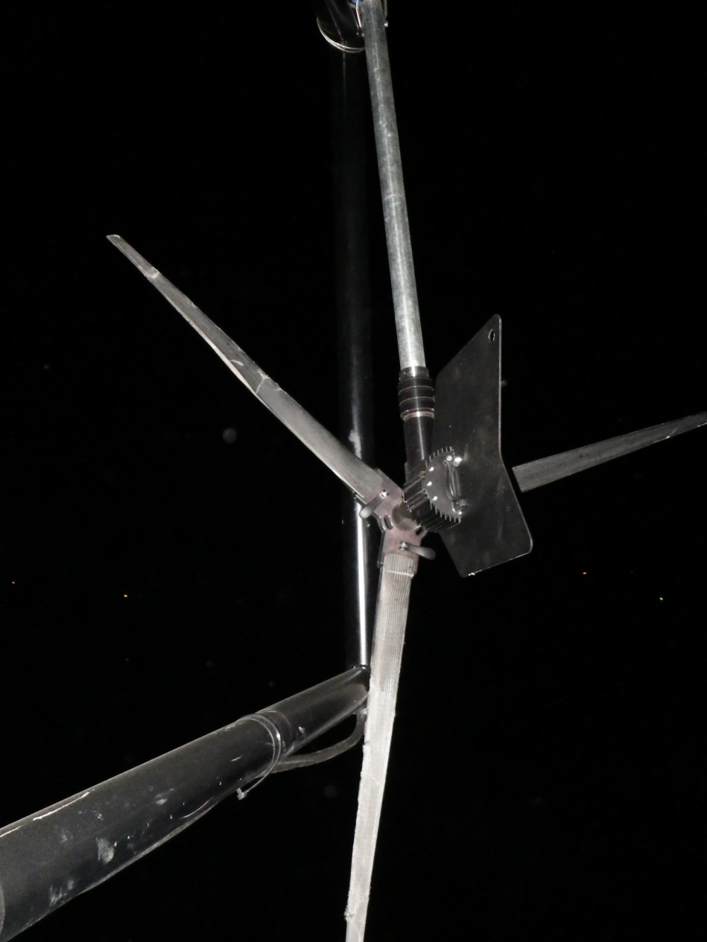
IP Camera Example, Continued
What I found

Slide 22
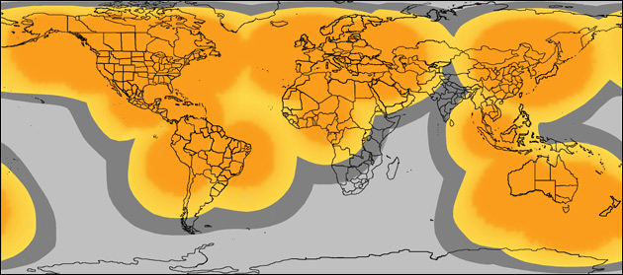
Telemetry - Satellite
APRS World / SPOT Satellite Telemetry
Globalstar network
Low cost SPOT network
<$400 hardware & <$100 year data
6 hour highly compressed message with
Wind speed / gust / average
Turbine RPM / average RPM / current
Temperature
Dump Load kWh, duty cycle, battery temperature
Battery Voltage

Slide 23
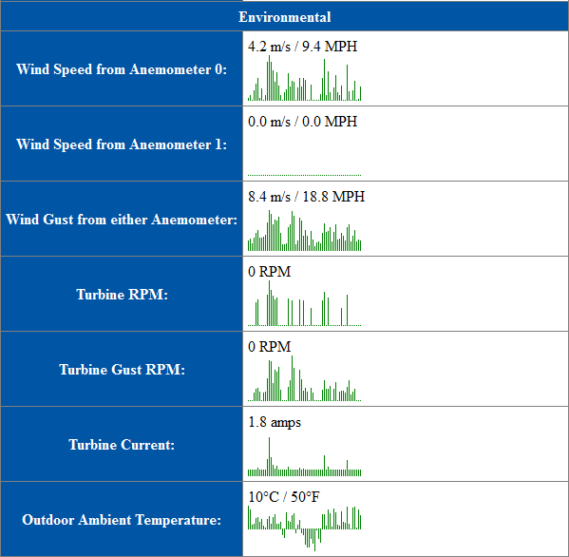
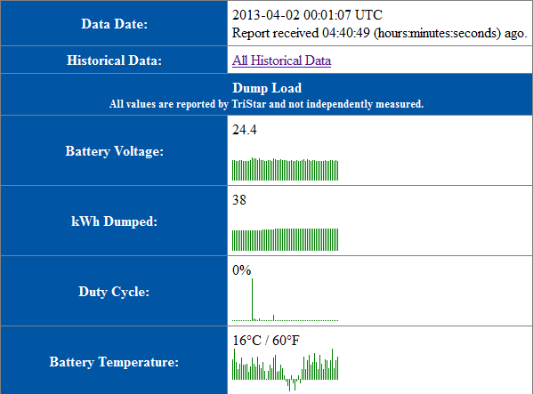
Satellite Telemetry Data Website
Example of “live” data:
Example of historical data:

Slide 24
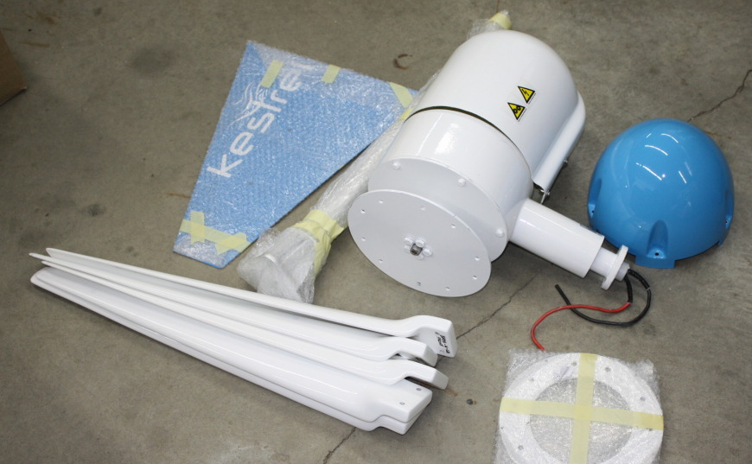
MRO
Do regular scheduled maintenance
Consider pre-emptive replacement of batteries and micro turbines

Slide 25
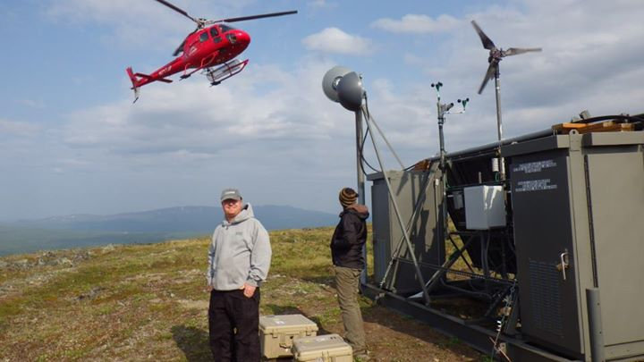
Conclusions
Use solar!
Use the best parts with best track record
Monitor and maintain system
Plan, plan, plan

