Slide 1
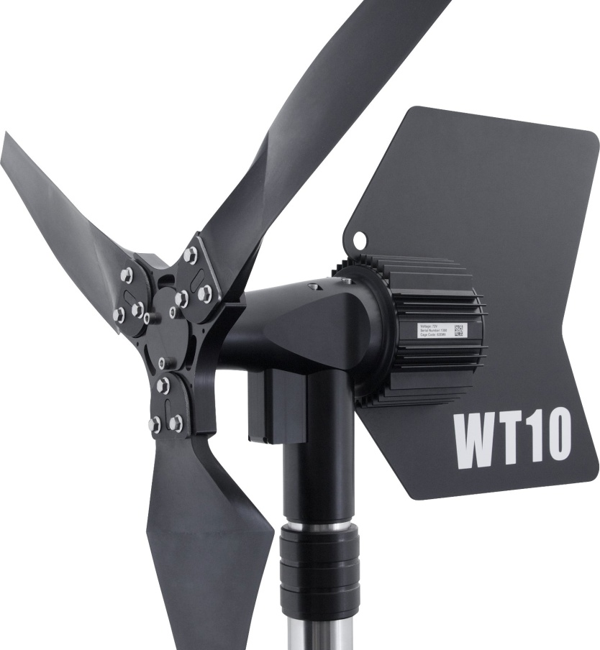
Low Cost, Low Temperature Lab Shop Testing
James Jarvis
APRS World, LLC
www.aprsworld.com

Slide 2
Need
South Pole field trial of WT10 wind turbine for IRIS / PASSCAL
-83°C to -12°C
APRS World WT10 wind turbine
bearings, seals & cables
Web Camera
operation
Instrumentation
operation and accuracy

Slide 3
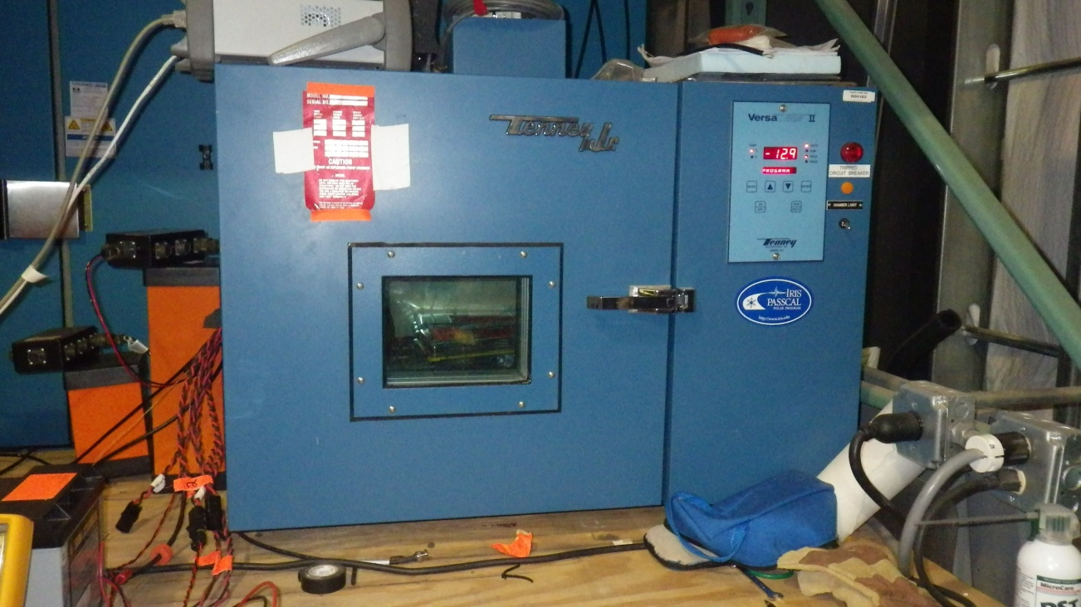
Traditional Approaches: Thermal Chamber
Pros
Cons
Fast
Accurate
Able to thermal shock DUT
Expensive
Fragile

Slide 4
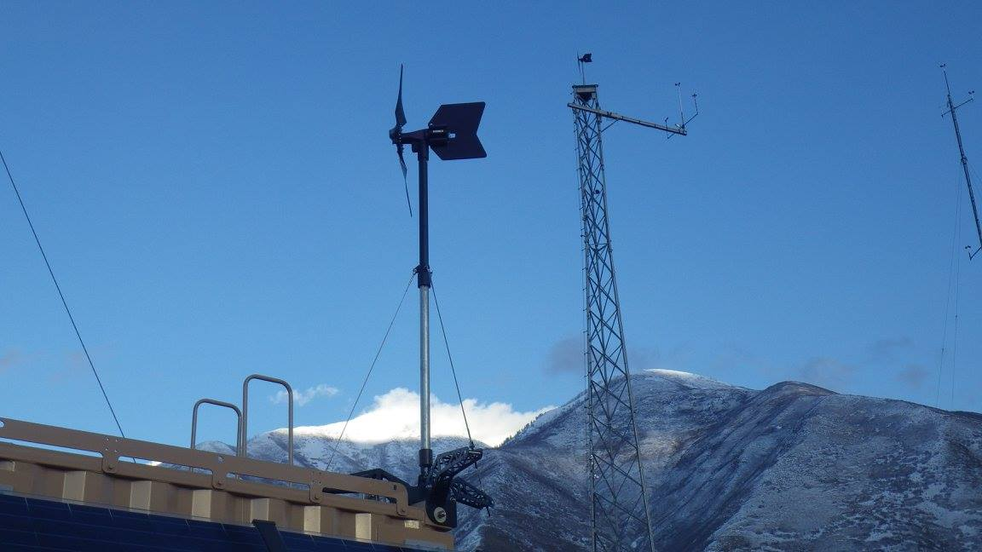
Traditional Approaches: Field Testing
Pros
Cons
Actual conditions
Unpredictable
Expensive
Slow

Slide 5
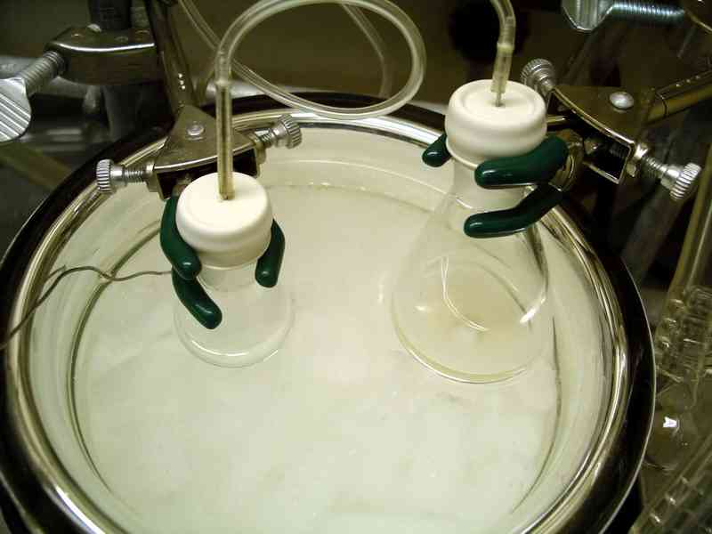
Traditional Approaches: Immersion (dry ice / acetone)
Pros
Cons
Easy
Available
Right temperature: -78°C
Liquid
Solvent compatibility
Very fast – thermal shocks
"Aldolrxnpic" by Original uploader was E kwan at en.wikipedia - Originally from en.wikipedia; description page is/was here.. Licensed under Public Domain via Wikimedia Commons - http://commons.wikimedia.org/wiki/File:Aldolrxnpic.jpg#/media/File:Aldolrxnpic.jpg

Slide 6
Idea: Ultra Freezer
Two common ranges:
-40°C and -85°C
Expensive new ($20k)
Cheap and plentiful used ($1k)
120V @ 20A or 240V @ 15A – easy!

Slide 7
Ultra Freezer Pitfalls
Often sold because they have problems
Compressors and refrigerant are expensive
Cascade system means that problem anywhere in system will require multiple compressors and refrigerant charges

Slide 8
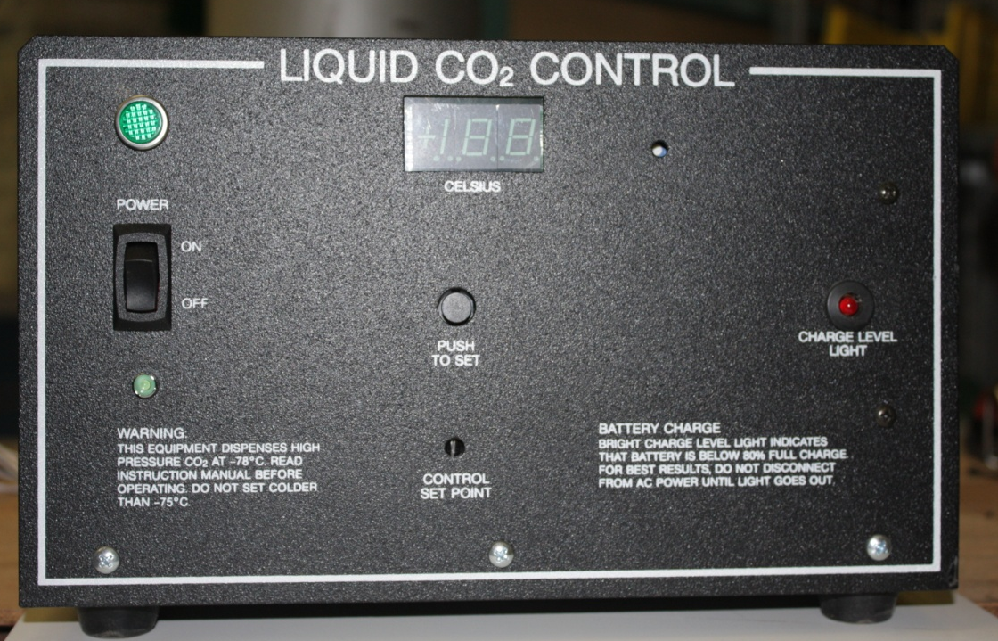
Getting Colder: Liquid CO₂
Sublimination point: -78.5°C
Cheap:$0.08 per pound
Off the shelf controllers
Readily available

Slide 9
APRS World’s freezers
Original -85°C worked for a few hours, then died
Only -40°C freezers available given time and price constraints

Slide 10
APRS World’s Freezer Modifications
So-Low -40°C Freezer
Liquid CO2 for sub -40°C operation
RTD (PT100) instrumentation
5cm instrumentation port

Slide 11
APRS World’s CO2 Controller Modifications
Replaced unusual fittings with NPT
Added solenoid indicator light
Removed dead backup battery
Designed and built missing CO2 discharge tube

Slide 12
RTD Temperature Instrumentation: ThermokLogger-RTD
4 x PT100 or PT1000 RTD 4-wire inputs
2 x programmable solid state relay outputs
SD card logging
Real time clock
LCD display
Optional wireless modems
RS-232 port

Slide 13
RTD Temperature Instrumentation: ThermokUSB-RTD2
2 x PT100 or PT1000 RTD 4-wire inputs
USB interface
Modbus or streaming ASCII
Small (4 x 4.5cm)
DIN rail mountable
Open Source
hardware
firmware
software

Slide 14
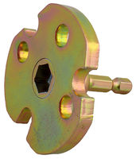
Bearing Friction Testing
12-volt cordless drill with drive adapter for WTAPRS
DC power / energy meter
Lower power to turn turbine at given RPM => less bearing losses

Slide 15
Instrumentation Port
2” SCH 40 Stainless Pipe
SCH 80 polypropylene pipe cap when not in use
Also provides CO₂ vent
Almost a disaster when installing
MFG instructions wrong!

Slide 16
Results: Test Setup
< $2000 able to obtain South Pole cold
Fast ramps down with CO2
Slow ramps with refrigeration
Stable
Good remote monitoring

Slide 17
CO₂ and Refrigeration Fast Ramp
°C
DUT powered up
-60°C set point reached
End of brief test
seconds

Slide 18
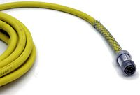
Results: WT10 / WT14
Bearings
Molykote 33 grease works great!
Standard low drag seals are okay
No short term ball clearance issues
Drop (output) cable “Carol Super Vu-Tron Supreme”
not bendable at “winter” temperatures
installable at “summer” temperatures
Blades (glass filled nylon)
gets stiffer as it gets colder
good!
field tested in Antarctica

Slide 19
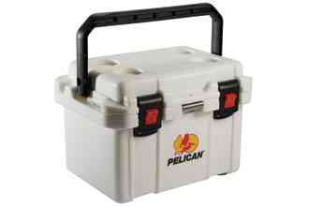
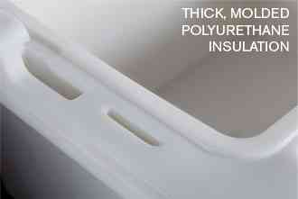
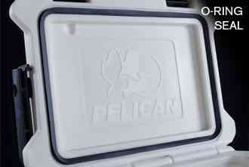
Results: Pelican Cooler
2 watts waste heat keeps cooler interior 20°C above outdoor ambient
Not bad for $250 MSRP COTS!

Slide 20
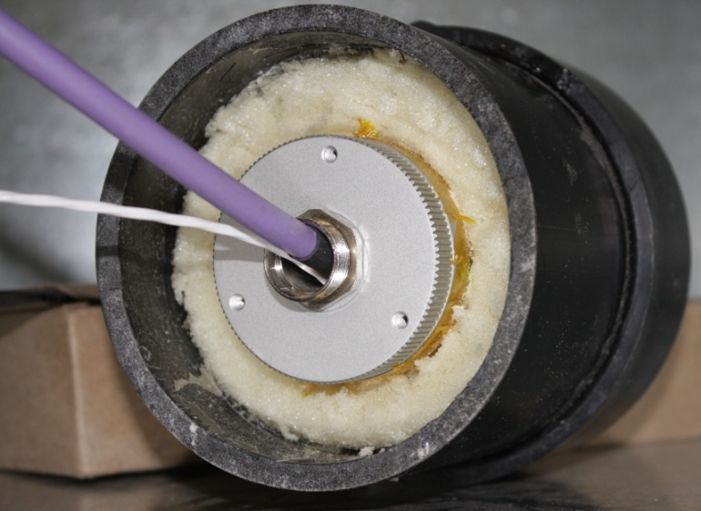
Results: IP Camera
Vivotek IP8364 rated to -20°C
Mechanical IR cut filter expected to be a problem
Polyurethane insulated ABS sleeve developed
Camera interior stays ~30°C above ambient

Slide 21
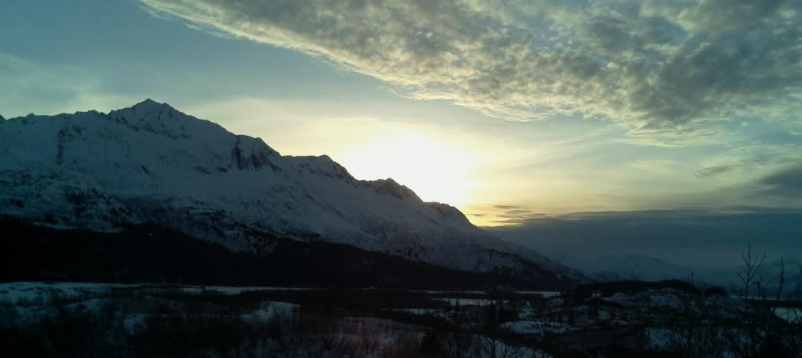
Results: Pi Camera / Weather Station
IP Camera
Weather Station
Wireless or 802.15.4 POE
~1 watts
IP67 enclosure
Linux based
Open source
Wide DC input voltage

Slide 22
Questions and Comments?
James Jarvis
APRS World, LLC
jj@aprsworld.com
507.454.2727
Information on our products:
http://www.aprsworld.com/

